Slide 1
Darkness at Noon
Arthur Koestler

Slide 2
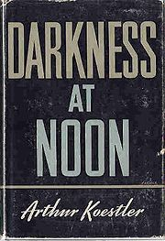

Slide 3
Background
Who was Koestler?
Context: I. Russian Revolution of 1917
Succession to Lenin?
-- NEP
-- First Five Year Plan
-- Politics of succession: Trotsky/ Bukharin/Zinoviev
--Moscow Trials: civilization? The “line”; intention

Slide 4
Succession
Trotsky
Bukharin
Zinoviev
Stalin

Slide 5
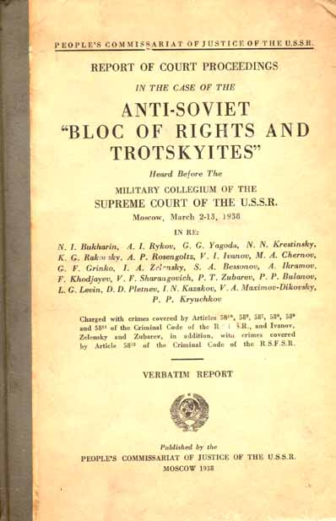
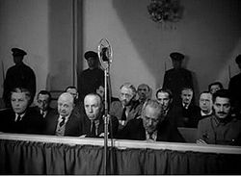

Slide 6
D at N: Dramatis personae
Rubashov – looks like Zinoviev and talks like Bukharin
Ivanov- old friend; first interrogator
Little Loewy and Richard – agents betrayed by R
Arlova – secretary-mistress; also betrayed
Gletkin – new apparatchik; second interrogator
Number One – Stalin
Old Man - Lenin

Slide 7
Metaphoric Context of the Book
“darkness at noon” – when?
Three interrogations. Why?
Context for Koestler
Forced collectivization
-- guilt and intention
--historical necessity (?)
-- the Party
Evaluation

