Slide 1
King Lear

Slide 2
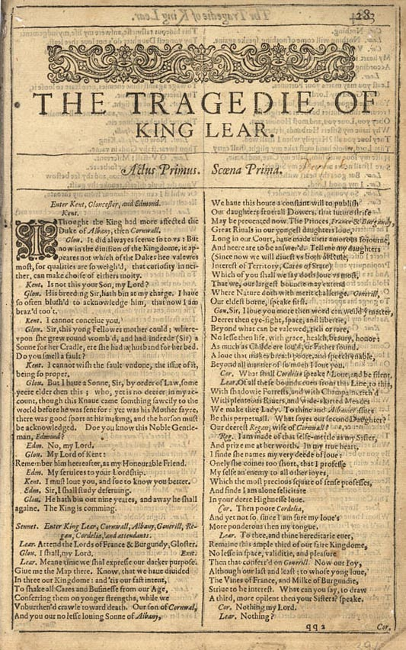
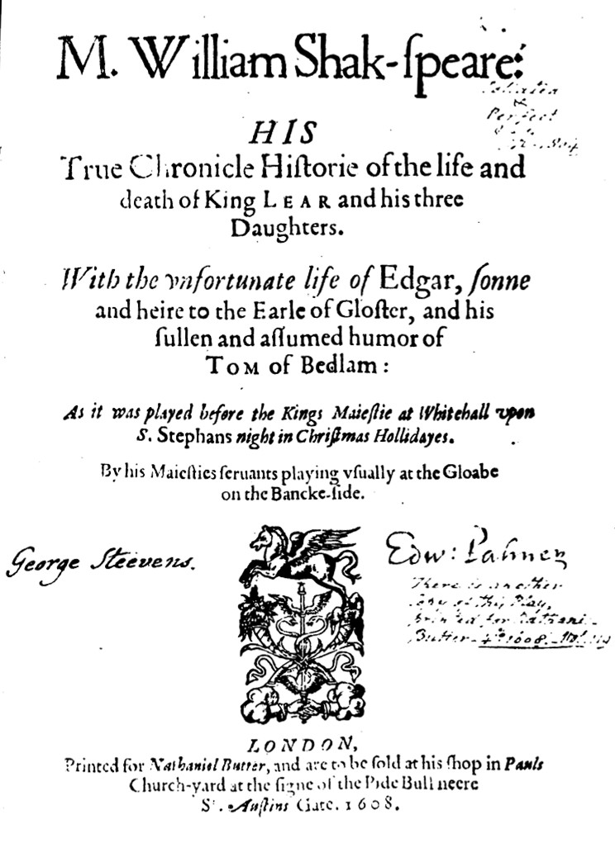
quarto- 1608
Folio – 1623- one of 33 plays

Slide 3
The Tempest – Epilogue to Act V
EPILOGUE SPOKEN BY PROSPERO Now my charms are all o'erthrown, And what strength I have's mine own, Which is most faint: now, 'tis true, I must be here confined by you, Or sent to Naples. Let me not, Since I have my dukedom got And pardon'd the deceiver, dwell In this bare island by your spell; But release me from my bands With the help of your good hands: Gentle breath of yours my sails Must fill, or else my project fails, Which was to please. Now I want Spirits to enforce, art to enchant, And my ending is despair, Unless I be relieved by prayer, Which pierces so that it assaults Mercy itself and frees all faults. As you from crimes would pardon'd be, Let your indulgence set me free.

Slide 4
King Lear Act I, scene 1
http://www.youtube.com/watch?v=zpaWNFo7I_E&playnext=1&list=PL7C010DA6260FA287&feature=results_video
http://www.youtube.com/watch?v=N4m3RYllbkQ 6:10
http://video.pbs.org/video/1075274407/

Slide 5
Lear, Act I, scene 1
Meantime we shall express our darker purpose. Give me the map there. Know that we have divided In three our kingdom: and 'tis our fast intent To shake all cares and business from our age; Conferring them on younger strengths, while we Unburthen'd crawl toward death. Our son of Cornwall, And you, our no less loving son of Albany, We have this hour a constant will to publish Our daughters' several dowers, that future strife May be prevented now. The princes, France and Burgundy, Great rivals in our youngest daughter's love, Long in our court have made their amorous sojourn, And here are to be answer'd. Tell me, my daughters,-- Since now we will divest us both of rule, Interest of territory, cares of state,-- Which of you shall we say doth love us most? That we our largest bounty may extend Where nature doth with merit challenge. Goneril, Our eldest-born, speak first.

Slide 6
Lear turns to Cordelia
KING LEAR: To thee and thine hereditary ever Remain this ample third of our fair kingdom; No less in space, validity, and pleasure, Than that conferr'd on Goneril. Now, our joy, Although the last, not least; to whose young love The vines of France and milk of Burgundy Strive to be interess'd; what can you say to draw A third more opulent than your sisters? Speak. CORDELIA:Nothing, my lord. KING LEAR:Nothing! CORDELIA:Nothing. KING LEAR:Nothing will come of nothing: speak again.

Slide 7
Act I, scene iv
Fool: Sirrah, I'll teach thee a speech. KING LEAR:Do. Fool:Mark it, nuncle: Have more than thou showest, Speak less than thou knowest, Lend less than thou owest, Ride more than thou goest, Learn more than thou trowest, Set less than thou throwest; Leave thy drink and thy whore, And keep in-a-door, And thou shalt have more Than two tens to a score. KENT:This is nothing, fool. Fool: Then 'tis like the breath of an unfee'd lawyer; you gave me nothing for't. Can you make no use of nothing, nuncle?

Slide 8
same
KING LEAR: Doth any here know me? This is not Lear: Doth Lear walk thus? speak thus? Where are his eyes? Either his notion weakens, his discernings Are lethargied--Ha! waking? 'tis not so. Who is it that can tell me who I am? Fool: Lear's shadow.

Slide 9
Act II, scene iv – who loves him the most (as measured in retinue)?
To GONERIL
I'll go with thee: Thy fifty yet doth double five and twenty, And thou art twice her love. GONERIL: Hear me, my lord; What need you five and twenty, ten, or five, To follow in a house where twice so many Have a command to tend you? REGAN: What need one?

Slide 10
Lear’s response
KING LEAR:
O, reason not the need: our basest beggars Are in the poorest thing superfluous: Allow not nature more than nature needs, Man's life's as cheap as beast's: thou art a lady; If only to go warm were gorgeous, Why, nature needs not what thou gorgeous wear'st, Which scarcely keeps thee warm. But, for true need,-- You heavens, give me that patience, patience I need! You see me here, you gods, a poor old man, As full of grief as age; wretched in both! If it be you that stir these daughters' hearts Against their father, fool me not so much To bear it tamely; touch me with noble anger, And let not women's weapons, water-drops, Stain my man's cheeks! No, you unnatural hags, I will have such revenges on you both, That all the world shall--I will do such things,-- What they are, yet I know not: but they shall be The terrors of the earth. You think I'll weep No, I'll not weep: I have full cause of weeping; but this heart Shall break into a hundred thousand flaws, Or ere I'll weep. O fool, I shall go mad!

Slide 11
Heath scene (III, iv)
To the Fool
In, boy; go first. You houseless poverty,-- Nay, get thee in. I'll pray, and then I'll sleep. Fool goes in
Poor naked wretches, whereso'er you are, That bide the pelting of this pitiless storm, How shall your houseless heads and unfed sides, Your loop'd and window'd raggedness, defend you From seasons such as these? O, I have ta'en Too little care of this! Take physic, pomp; Expose thyself to feel what wretches feel, That thou mayst shake the superflux to them, And show the heavens more just.

Slide 12
IV 6 – “The cliffs of Dover” 1:47
GLOUCESTER:Set me where you stand. EDGAR: Give me your hand: you are now within a foot Of the extreme verge: for all beneath the moon Would I not leap upright. GLOUCESTER: Let go my hand. Here, friend, 's another purse; in it a jewel Well worth a pooa man's taking: fairies and gods Prosper it with thee! Go thou farther off; Bid me farewell, and let me hear thee going. EDGAR: Now fare you well, good sir. GLOUCESTER: With all my heart.
GLOUCESTER[Kneeling] O you mighty gods! This world I do renounce, and, in your sights, Shake patiently my great affliction off: If I could bear it longer, and not fall To quarrel with your great opposeless wills, My snuff and loathed part of nature should Burn itself out. If Edgar live, O, bless him! Now, fellow, fare thee well. He falls forward
EDGAR Gone, sir: farewell. And yet I know not how conceit may rob The treasury of life, when life itself Yields to the theft: had he been where he thought, By this, had thought been past. Alive or dead? Ho, you sir! friend! Hear you, sir! speak! Thus might he pass indeed: yet he revives. What are you, sir? GLOUCESTER Away, and let me die. EDGAR Hadst thou been aught but gossamer, feathers, air, So many fathom down precipitating, Thou'dst shiver'd like an egg: but thou dost breathe; Hast heavy substance; bleed'st not; speak'st; art sound. Ten masts at each make not the altitude Which thou hast perpendicularly fell: Thy life's a miracle. Speak yet again. GLOUCESTER But have I fall'n, or no?

Slide 13
IV 6 – with Lear
GLOUCESTER O, let me kiss that hand! KING LEAR Let me wipe it first; it smells of mortality. GLOUCESTER O ruin'd piece of nature! This great world Shall so wear out to nought. Dost thou know me? KING LEAR I remember thine eyes well enough. Dost thou squiny at me? No, do thy worst, blind Cupid! I'll not love. Read thou this challenge; mark but the penning of it. GLOUCESTER Were all the letters suns, I could not see one. EDGAR I would not take this from report; it is, And my heart breaks at it. KING LEAR Read.
GLOUCESTER What, with the case of eyes? KING LEAR O, ho, are you there with me? No eyes in your head, nor no money in your purse? Your eyes are in a heavy case, your purse in a light; yet you see how this world goes.
Get thee glass eyes; And like a scurvy politician, seem To see the things thou dost not. Now, now, now, now: Pull off my boots: harder, harder: so. EDGAR O, matter and impertinency mix'd! Reason in madness! KING LEAR If thou wilt weep my fortunes, take my eyes. I know thee well enough; thy name is Gloucester: Thou must be patient; we came crying hither: Thou know'st, the first time that we smell the air, We wawl and cry. I will preach to thee: mark. GLOUCESTER Alack, alack the day!

