Slide 1
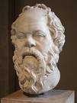
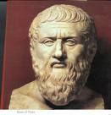
Plato / Socrates
Sources: Plato; Xenophon; Aristophanes; Aristotle; Diogenes Laertius, and others

Slide 2
PNYX

Slide 3
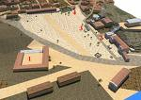
Agora – 4th century BC

Slide 4
Plan of agora; jail in SW corner
HEARING- Euthyphro
TRIAL
JAIL

Slide 5
Plato, Socrates and the Platonic Method
Socrates: sources in Plato, Aristotle, Xenophon, Aristophanes, and later writers
Writes nothing
Never leaves Athens except twice
Method: elenchus ; the Delphic oracle
Plato: poet; noble; disciple; 36 dialogues and 13 letters (doubts about some) [Stephanus ##]
What is philosophy about?

Slide 6
Plato – letter Seven
Once more, less hastily this time, but surely, I was moved by the desire to take part in public life and in politics. TO be sure, in those days too, full of disturbance as they were, there were many things occurring to cause offense, nor is it surprising that in time of revolution men in some cases took undue revenge on their enemies… As it chanced, however, some of those in control brought against the associate of mine, Socrates, .. a most sacrilegious charge, which he, least of all men, deserved. They put him on trial for impiety and the people condemned and put to death the man who had refused to take part in the wicked arrest of one of their friends, whose exile had coincided with their own exile and misfortunes. (Letters, 325c)

Slide 7
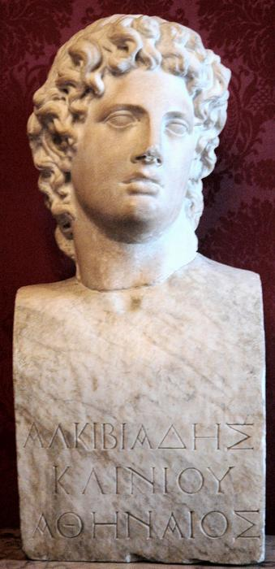
Protagoras
Protagoras and sophists
Opening Frame with exchange about Alcibiades
Compare to ending
Enter Hippocrates
What does he want?
What does Socrates do?
Visit to Callias’s house

Slide 8
References to Odyssey, book XI
"I saw also the dreadful fate of Tantalus, who stood in a lake that reached his chin; he was dying to quench his thirst, but could never reach the water, for whenever the poor creature stooped to drink, it dried up and vanished, so that there was nothing but dry ground- parched by the spite of heaven. There were tall trees, moreover, that shed their fruit over his head- pears, pomegranates, apples, sweet figs and juicy olives, but whenever the poor creature stretched out his hand to take some, the wind tossed the branches back again to the clouds.
"And I saw Sisyphus at his endless task raising his prodigious stone with both his hands. With hands and feet he' tried to roll it up to the top of the hill, but always, just before he could roll it over on to the other side, its weight would be too much for him, and the pitiless stone would come thundering down again on to the plain. Then he would begin trying to push it up hill again, and the sweat ran off him and the steam rose after him.
"After him I saw mighty Hercules, but it was his phantom only, for he is feasting ever with the immortal gods, and has lovely Hebe to wife, who is daughter of Jove and Juno. The ghosts were screaming round him like scared birds flying all whithers. He looked black as night with his bare bow in his hands and his arrow on the string, glaring around as though ever on the point of taking aim. About his breast there was a wondrous golden belt adorned in the most marvellous fashion with bears, wild boars, and lions with gleaming eyes; there was also war, battle, and death. The man who made that belt, do what he might, would never be able to make another like it. Hercules knew me at once when he saw me, and spoke piteously, saying, my poor Ulysses, noble son of Laertes, are you too leading the same sorry kind of life that I did when I was above ground? I was son of Jove, but I went through an infinity of suffering, for I became bondsman to one who was far beneath me- a low fellow who set me all manner of labours. He once sent me here to fetch the hell-hound- for he did not think he could find anything harder for me than this, but I got the hound out of Hades and brought him to him, for Mercury and Minerva helped me.'

Slide 9
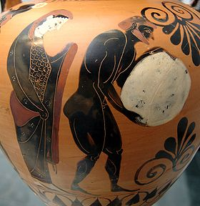
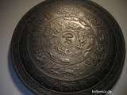
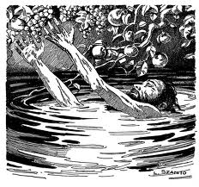
Athens
(Satyrus) Socrates (eunuch)
Eros out of control no Eros
democracy of virtue no virtue
______________________________________________________________________________________
Hippocrates confused
health flattery
doctor Socrates sculptor
_______________________________________________________________________________________
Protagoras
Hippias Prodicus
Heracles Sisyphus Tantalus
(might is right) inability to keep an answer knowledge is useless
Epimetheus (afterthought, experience, pain/pleasure)
CHOICE: or
Prometheus (forethought, philosophy, virtue)
“THE VIRGINIA REEL” IN CALLIAS’S COURTYARD

Slide 10
The agon starts
Note contest aspects: the issue is if virtue can be taught (not politically irrelevant)
Protagoras
Humans learn by reward and punishment
Thus it can be taught be some are better teachers
Virtue is having learned from correctly understood experience

Slide 11
Socrates’s response
Sense of incompleteness of Prot.’s arg.
Let’s talk about something else (makes to leave)
Protrgs proposes a poetry interpretation
Simonides
Quote from Hesiod is key

Slide 12
Why such tortuousness?
The dialogue and political education – what does it mean to learn?
Summary of Protagoras
Contrast to Prometheus
“prothumia” (Pericles?)

Slide 13
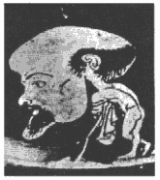
Sophists getting paid
Caricature – about 440 BCE - Louvre

Slide 14
Apology
I. Socrates has been accused of impiety and corrupting youth. The Apology (Grk: defense) is his defense
A. previous dialogue is Euthyphro.
1. takes place on way to the court of the king-archon (court for religious matters). In front of tablet of laws.
a) Euthyphro is prosecuting his own father for the murder of a laborer who is a murderer
(1) E says his family and friends believe him to be impious is doing so. He says no, but discussion reveals that he doesn't know what piety is. See last paragraph
B. Where are we in history: loss during the Peloponnesian War
1. Apology starts with problem of identity
a) I was almost carried away -- "I almost forgot my own self"
2. We might say that S finds himself a stranger in his city
a) with whom is this dialogue
(1) not with people (except Meletus)
(2) with city as a whole
(a) which is reduced to grunts and cries and exercise of power
i) sounds not words
(b) still not all bad since vote indicates that 40% acquit, 40 % no and 20% can be swayed

Slide 15
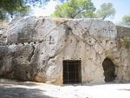
JAIL

Slide 16
b) what is with the polis as a whole
(1) it is been badly taught and socialized (18B)
(2) there are too many who do no owe who they are to the city (20A) cf Protagoras and Sophists
(3) too much concern with money and prestige (29d)
c) the city has accused him for there is a popular prejudice against him (cf Aristophanes who is mentioned) and he finds himself forced to speak in an unfamiliar way -- almost a foreign language
(1) indeed, were there more time (37b) he could have persuaded them

Slide 17
Sophists getting paid
Caricature – about 440 BCE - Louvre

Slide 18
3. why does he have this problem?
a) he knows nothing of the things above the earth or below -- ie only knows of human affairs (19d)
b) and he has been trying to disprove what the gods say about him (Oedipus)
(1) impact of Delphi
(a) there is none wiser
(b) know thyself
i) implication is that we are not wise because we do not wish to know ourselves
(c) in trying to disprove the God S will become who he is, but will not as he says in 37d, be like Oedipus and be driven from the city

Slide 19
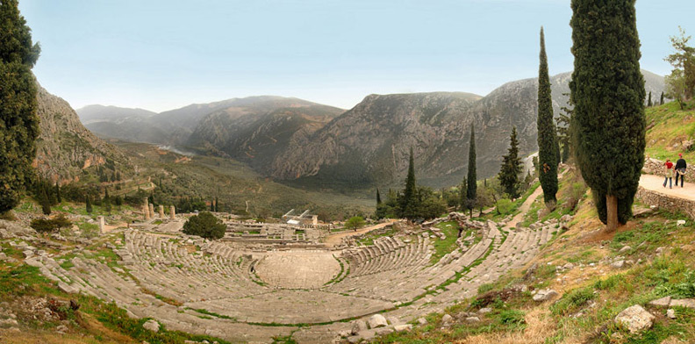
DELPHI – Theater and Temple of Apollo

Slide 20
Temple of Apollo

Slide 21
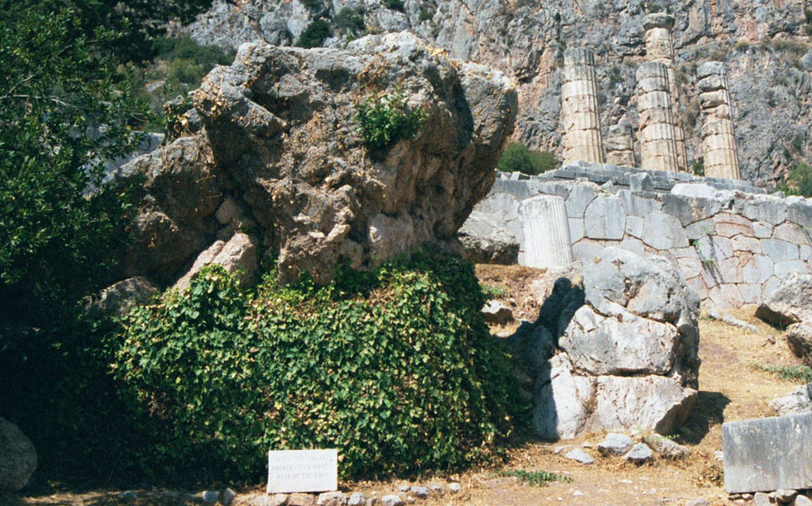
Rock where priestess prophesized (volcanic fumes):
gnothi seauton – know thyself

Slide 22
(2) consequences
(a) there are more important things to living that being alive (contra Hobbes)
i) the unexamined life is not worth living (38a)
ii) will not have it from authority that we uncritically accept
iii) knowledge will help us solve our social problems
i) because: we will not have the answer from received tradition
ii) why do most men lead the unexamined life

Slide 23
4. What is S's reaction to his accusers
a) The exchange with Meletus is unusual at that time in Athens
b) he claims to be other than human in his devotion to the city (31b)
(1) he has been totally a person of the city
(2) never followed his own interest
(a) indeed this is what allows him to hold to his station
5. response thus is:
a) I have no knowledge of the gods so I can't talk about it
b) to the corruption of youth he turns Meletus aside

Slide 24
6. After his condemnation he suggests that he requests as punishment free meals in the prytaneum -- the prize for Olympic race winners -- then that he should be fined -- thirty pieces of silver
a) it is clear that he practically calls for death –why?

Slide 25
CRITO
CRITO
II. DIALOGUE seems to have taken place on the 1000 anniversary of the foundation of Athens
A. reminder of where we are
B. Socrates says he won’t go
C. Crito says:
1. public opinion will damn you
2. your friends
3. your children
4. and furthermore its cowardice
a) agon and running away
(1) a powerful argument: by not caring for public opinion you have arrived at a position in which public opinion will destroy your reputation

Slide 26
D. Crito care deeply but is impatient with argument
1. Socrates' first task is to confuse him (by 47a)
2. here the problem is to get Crito to move from action to thought (48d)
a) his move is "I know you are right but what are we going to DO
3. BUT Crito has also raised the question of if it is just to do philosophy doesn't it make you an enemy to your neighbors
E. Crito cannot understand the abstract argument (50A) about states so Socrates is force to anthropomorphize and raise the question of the agon --
1. here though it is another opponent: in Apology it was andres Athenai; here it is the state.
a) Socrates can loose to the state but not to the men of Athens. In fact to loose to the former is to beat the latter.

Slide 27
2. How does this work: he tells the story of the nomoi kai to koinon
a) we conclude:
(1) the standards for criticizing Athens are derived from Athens
(2) to condemn S is to condemn Athens
(3) philosophy has its source in politics (not the other way around -- it cannot be transported around like Protagoras)
(4) By being a good citizen he shows what is wrong with his city
(a) by staying he shows the truth of his teaching that it is better to suffer than to inflict injustice

Slide 28
F. What do we make of S?
1. he construes who he is as purely emanating from Athens
2. his disobedience is to a law but not to LAW
3. one can say that I should disobey this law without saying that there should be no law
4. if we push the question of what S has a duty to stay we are asking why a duty obliges
a) self knowledge is the answer to this
III. BUT there is a problem:
A. Crito is convinced enough to allow S to stay, but he is not changed -- he doesn't see. He is just the same.
A central problem: S has only beaten Crito at his own game; he has not changed him; he has not gotten him to become a better person. Cf the Hesiod quote

Slide 29
Death of Socrates Jean Louis David, 1787

