Slide 1

Samuel Beckett, 1906-1989
“Compared with the realities of war and oppression that surround us, the gravest imaginings of the poets are diminished to a scale of private or artificial terror.”
-- George Steiner

Slide 2
Irish; short academic career in Ireland; friend of James Joyce; moves to Paris; publishes poetry and novels; friend of Duchamp and other modernists; worked and fought in French Resistance after invasion of France in
1940 (decorated post-war);
1953-55: Waiting for Godot (Beckett "has achieved a theoretical impossibility—a play in which nothing happens, that yet keeps audiences glued to their seats. What's more, since the second act is a subtly different reprise of the first, he has written a play in which nothing happens, twice.“)
1957: Endgame;
1969 Nobel Prize for
Literature

Slide 3

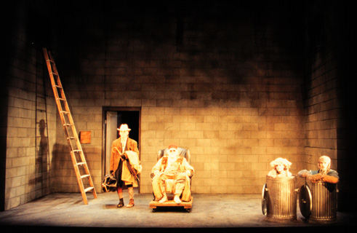
“Why, Mr. Beckett, with your despair about language and words do you continue to write? – That is what I am trying to find out.”

Slide 4
Dramatis personae
Hamm: can’t stand up; blind
Clov: can’t sit down
Nagg: father, amputee in ashcan
Nell: mother, amputee in ashcan
  “lost [their legs] when they crashed on the tandem”

Slide 5

quotes
The end is in the beginning and yet you go on.” (H: 77)
“I use the words you taught me. If they don't mean anything any more, teach me others. Or let me be silent.” (C: 51)
“Nothing is funnier than unhappiness, I grant you that… Yes, yes, it's the most comical thing in the world. And we laugh, we laugh, with a will, in the beginning. But it's always the same thing. Yes, it's like the funny story we have heard too often, we still find it funny, but we don't laugh any more.” (Nell: 26)
“I love order. It's my dream. A world where all would be silent and still, and each thing in its last place, under the last dust.” (C: 66)
Old endgame lost of old, play and lose and have done with losing.” (H: 90)

Slide 6
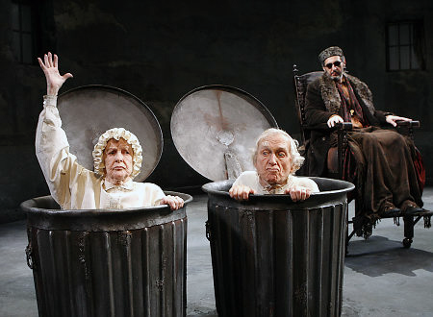
http://www.youtube.com/watch?v=Joj4Akj_rPo
http://www.youtube.com/watch?v=ChtKbACjAsw

Slide 7
The play
Clues from the names?
What is the play about?
  Ordinariness
    Family
    Quality of language
    Relation of our language to our world
    Can we defeat language?
    What kind of language ?
      Repartee
      Riddle
      Revelation
      Repetition
  Where and when does the play take place?
  Attitude towards hope
  Relation to audience
    If “You” “remain” [end of play] what are we to make of that?

Slide 8
Something like this in Dr. Strangelove (Kubrick)
http://www.youtube.com/watch?v=RLPnnPHkIuc

Slide 9
“In the present one is forsaken.”
“As an example by which you may the better understand this state of abandonment, I will refer to the case of a pupil of mine, who sought me out in the following circumstances. His father was quarrelling with his mother and was also inclined to be a “collaborator”; his elder brother had been killed in the German offensive of 1940 and this young man, with a sentiment somewhat primitive but generous, burned to avenge him. His mother was living alone with him, deeply afflicted by the semi-treason of his father and by the death of her eldest son, and her one consolation was in this young man. But he, at this moment, had the choice between going to England to join the Free French Forces or of staying near his mother and helping her to live. He fully realised that this woman lived only for him and that his disappearance – or perhaps his death – would plunge her into despair. He also realised that, concretely and in fact, every action he performed on his mother’s behalf would be sure of effect in the sense of aiding her to live, whereas anything he did in order to go and fight would be an ambiguous action which might vanish like water into sand and serve no purpose. For instance, to set out for England he would have to wait indefinitely in a Spanish camp on the way through Spain; or, on arriving in England or in Algiers he might be put into an office to fill up forms. Consequently, he found himself confronted by two very different modes of action; the one concrete, immediate, but directed towards only one individual; and the other an action addressed to an end infinitely greater, a national collectivity, but for that very reason ambiguous – and it might be frustrated on the way. At the same time, he was hesitating between two kinds of morality; on the one side the morality of sympathy, of personal devotion and, on the other side, a morality of wider scope but of more debatable validity. He had to choose between those two. What could help him to choose? “
Sartre, “Existentialism is a Humanism”

Slide 10
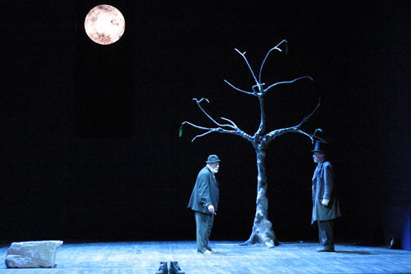
Augustine - CONFESSIONS
“Do not despair, for one of the thieves was saved. Do not presume for one of the thieves was damned.” (Offered by Beckett as a way of understanding Waiting for Godot)

