Slide 1
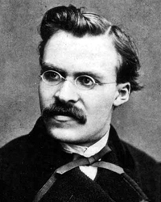
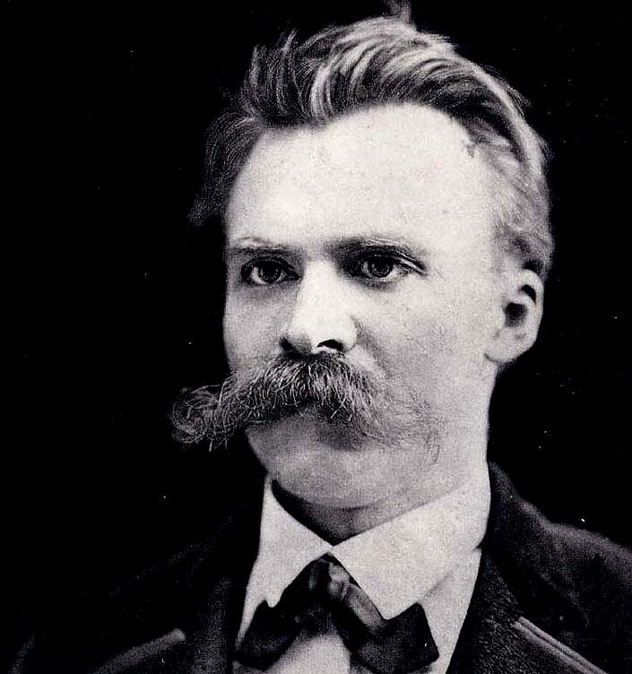
The Birth of Tragedy from the Spirit of Music
By
Friedrich Nietzsche

Slide 2
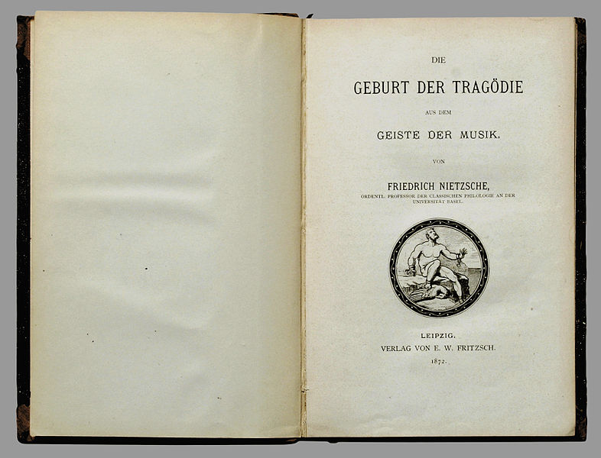

Slide 3
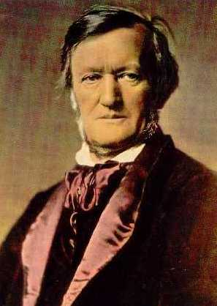
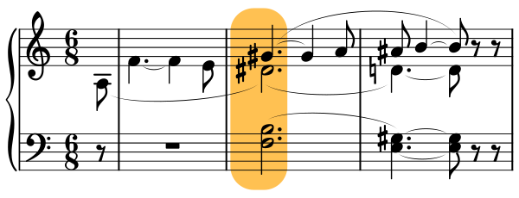
Richard Wagner
http://en.wikipedia.org/wiki/Piano_Sonata_No._16_(Mozart)
“Tristan chord”
http://www.youtube.com/watch?v=fuPDMhyGKB8

Slide 4
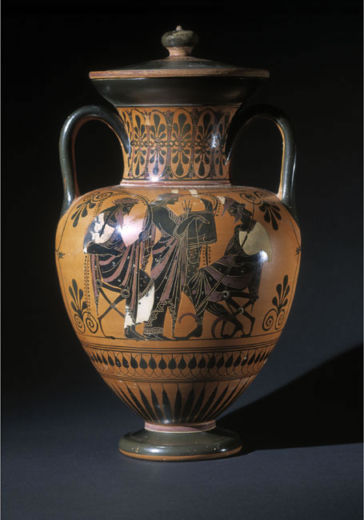
Apollo entertaining Dionysos – Lysipiddes painter, c 530BC
We will have achieved much for scientific
study of aesthetics when we come,
not merely to a logical understanding,
but also to the certain and immediate
apprehension of the fact that the further
development of art is bound up with
the doubleness of the Apollonian and the
Dionysian: in a manner similar to that in which
generation depends upon the duality of the
sexes, their continuing strife and only
periodically occurring reconciliation.
We take these names from the Greeks,
who gave a clear voice to the profound
secret teachings of their contemplative art,
not in concepts, but in the powerfully clear
forms of their divine world. (Birth, 1)

Slide 5
detail
[
[

Slide 6
Musical references
Die Meistersinger von Nurnberg
Beethoven, IXth symphony, last movement

Slide 7
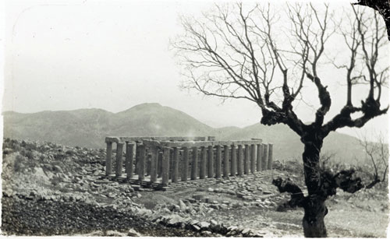
Temple of Apollo Epikourous, Bassae, Arcadia (Iktinos, architect); 5th C.
view from Southeast
First of all we see the glorious Olympian figures of the gods, standing on the gables of this structure. Their deeds, pictured in briliiant reliefs, adorn its friezes. -- Birth, 3

Slide 8
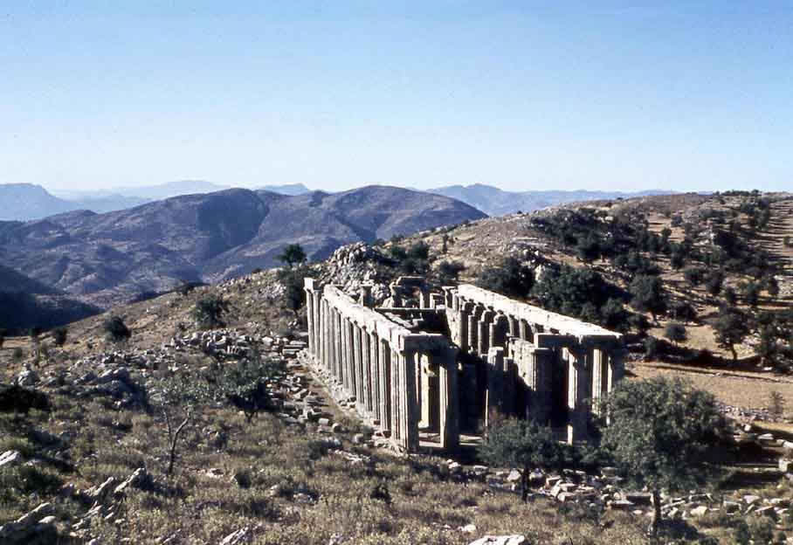
View from South

Slide 9
parthenon
First of all we see the glorious Olympian figures of the gods, standing on the gables of this structure. Their deeds, pictured in briliiant reliefs, adorn its friezes. -- Birth, 3

Slide 10
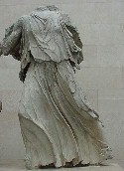
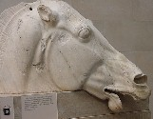
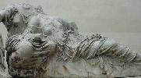
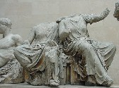
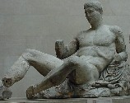
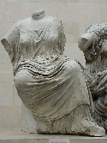

Slide 11
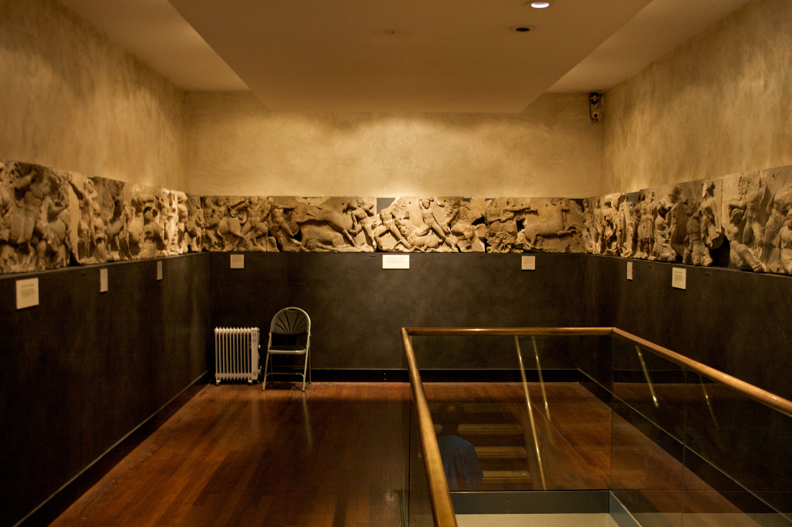

Slide 12
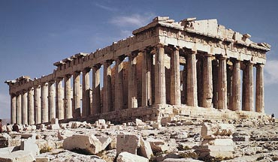

Slide 13
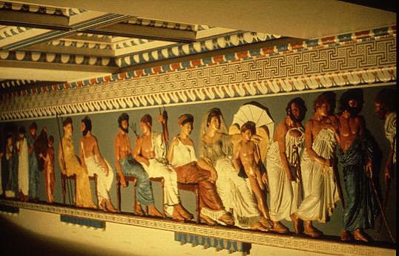
What it looked like

Slide 14
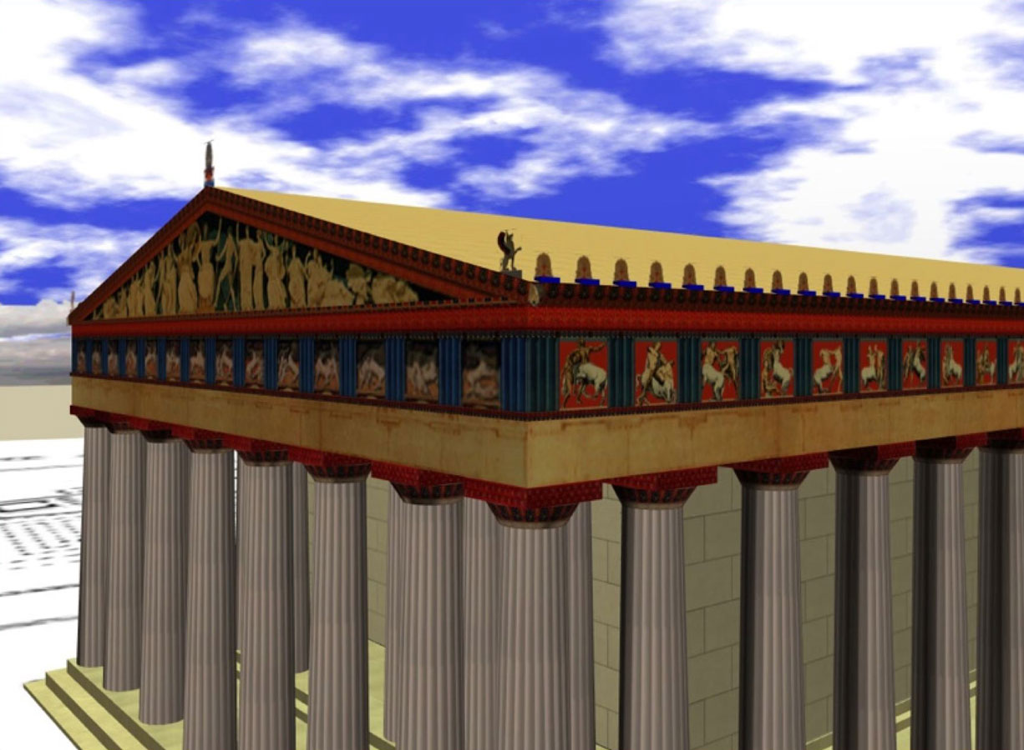
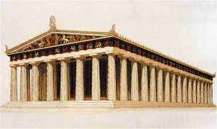

Slide 15
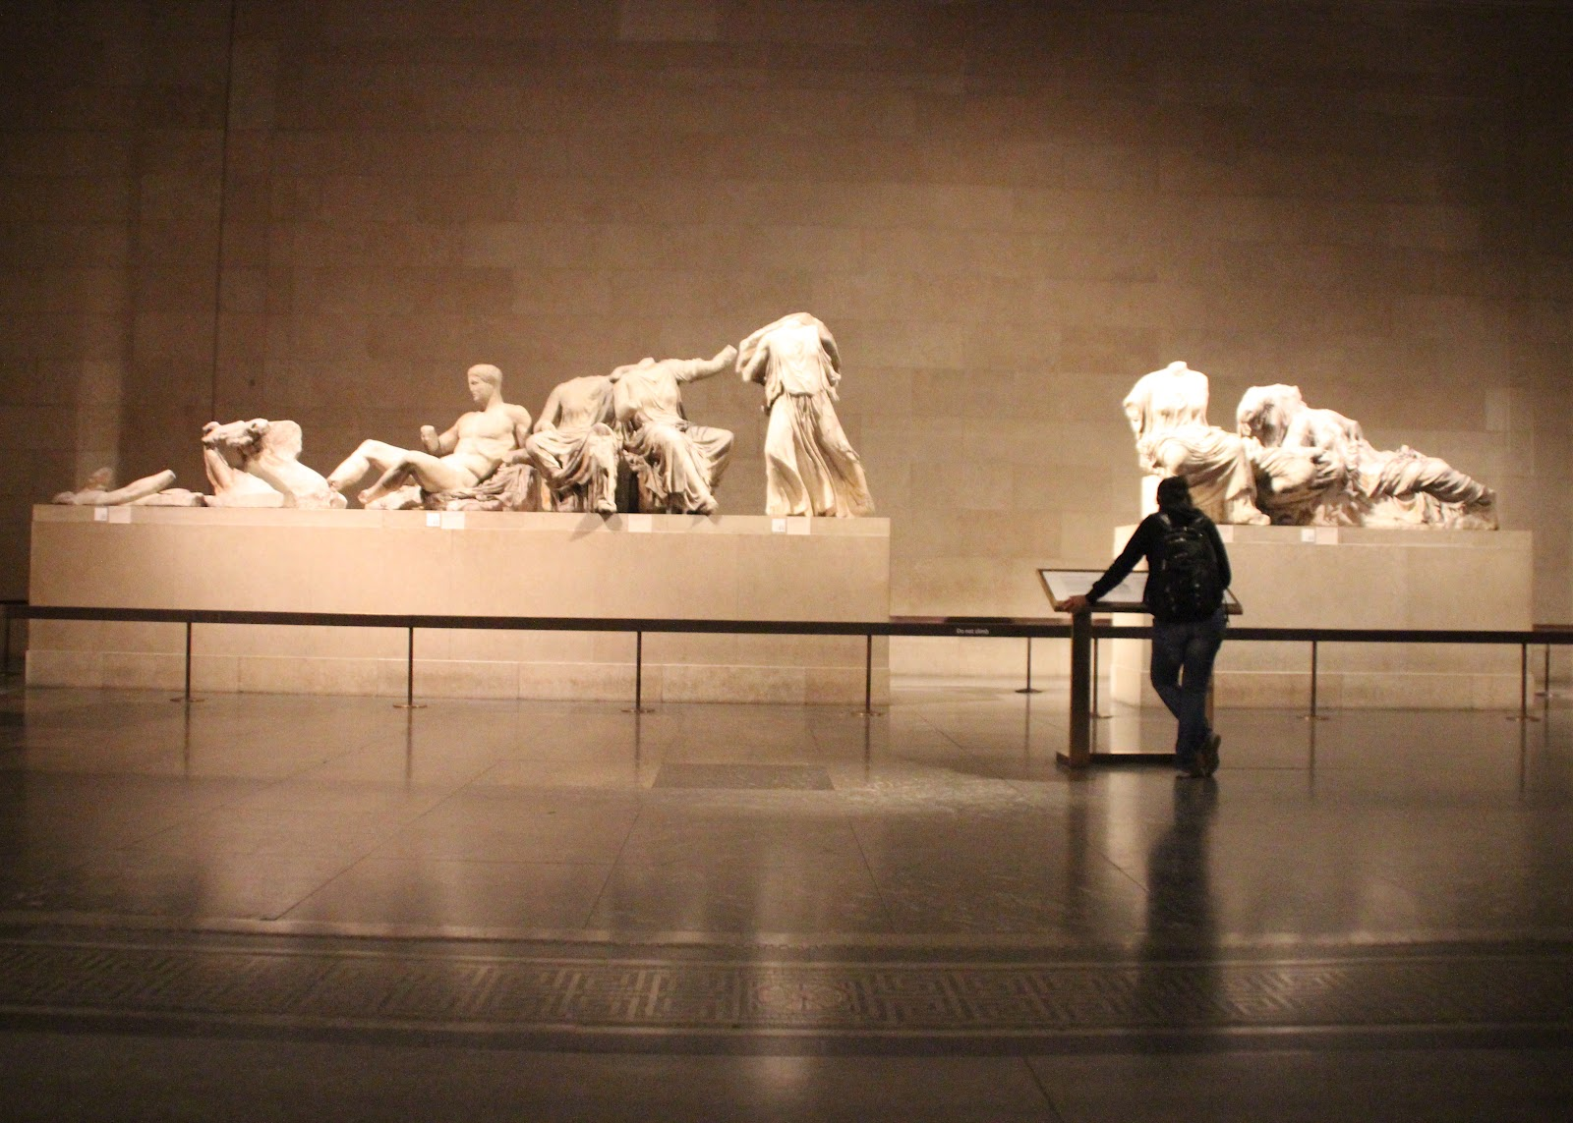

Slide 16
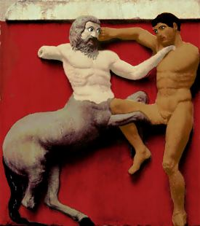
“Elgin” marbles from Parthenon
Dull is the eye that will not weep to see Thy walls defaced, thy mouldering shrines removed By British hands, which it had best behoved To guard those relics ne'er to be restored. Curst be the hour when from their isle they roved, And once again thy hapless bosom gored, And snatch'd thy shrinking gods to northern climes abhorred!
Lord Byron, "Childe Harold”

Slide 17
Raphael, Transfiguration
In a symbolic painting, Raphael, himself one of these immortal ‘naïve’ ones, has represented for us this demotion of appearance to the level of mere appearance, the primitive process of the naïve artist and of Apollinian culture.”
Birth, 4

Slide 18
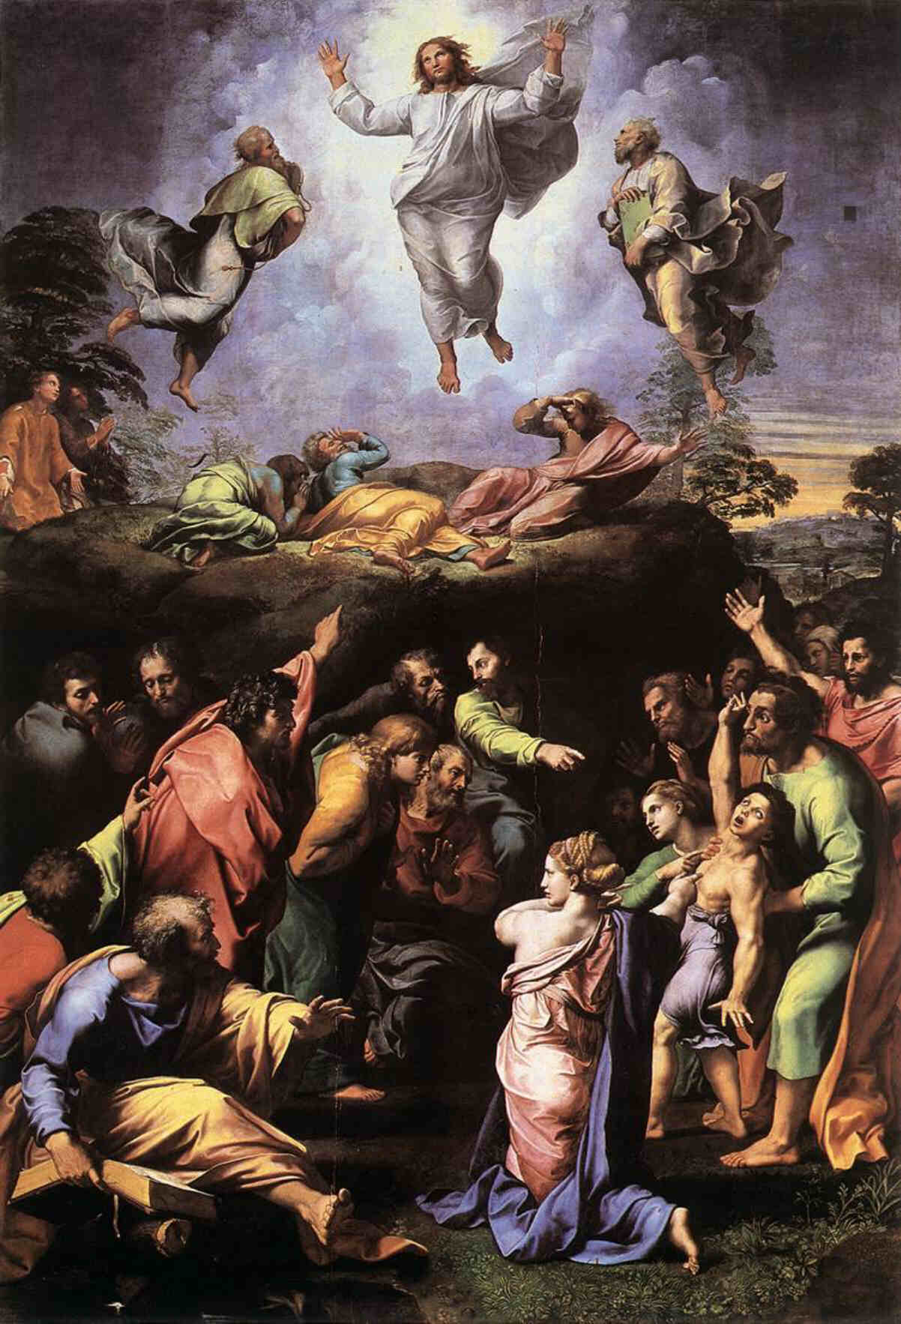
Figure 2

Slide 19
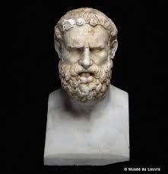
Archilochus: Birth, 5, 6
I know how to lead off
The sprightly dance
Of the Lord Dionysos,
the dithyramb,
I do it thunderstruck
With wine.
Archilochus, fragment 120

Slide 20
Overlooking - Ubersehen
A public of spectators as we know it was unknown to the Greeks: in their theaters the terraced structure of the concentric arcs of the spectator-place made it possible for everyone actually to overlook (übersehen) the whole world of culture around him and to imagine, in absorbed concentration, that he himself was a chorist. … The Dionysian excitement is capable of communicating this artistic gift to a multitude, that of seeing themselves surrounded by such a host of spirits, knowing that one is inwardly one with them. This process of the tragic chorus is the dramatic protophenomenon: to see oneself [as on stage] transformed before oneself [as seating as audience] and now to behave as if one had actually entered into another body, into another character. This process stands at the beginning of the development of the drama.”
-- Birth of Tragedy, 8

Slide 21
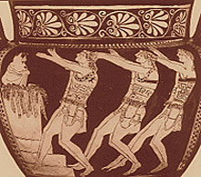
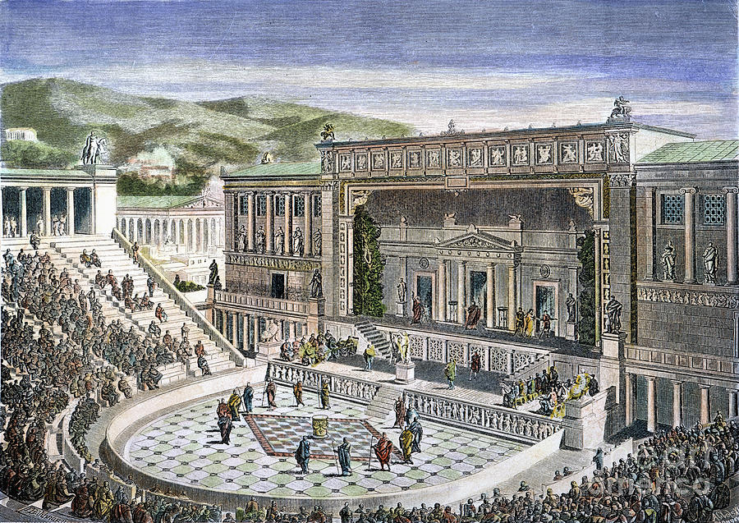
Chorus – Birth 7

Slide 22
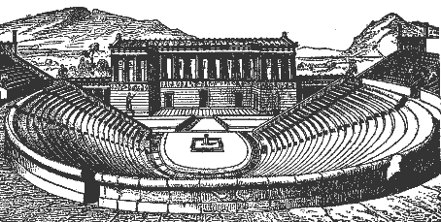
“the terraced structure of the concentric arcs of the spectator-place make it possible for everybody actually to overlook the whole world of culture around him and to imagine in absorbed contemplation that he himself was a chorist.” – Birth, 8

Slide 23
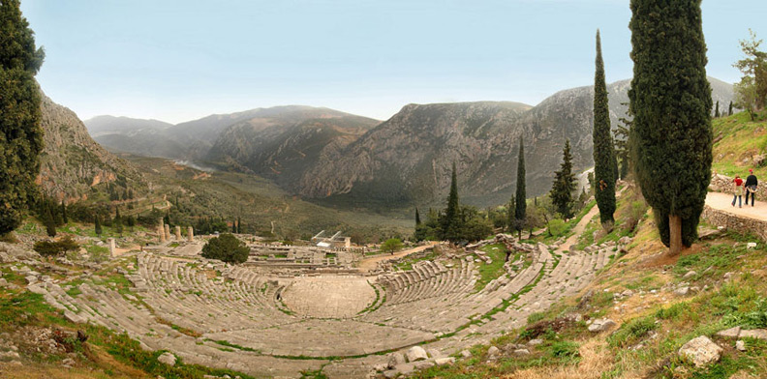
Temple of Apollo and theater at Delphi: Ubersehen - Overlooking „Die Griechen sagten, der Hexameter sei in Delphi erfunden“ (GS 84)

Slide 24
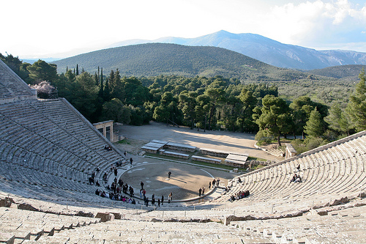
Epidaurus
Epidaurus

Slide 25
In this enchanted state, the Dionysian reveler sees himself as a satyr, and as a satyr, in turn he sees the god, which means that in his transformation he beholds another vision outside himself, as the apollonian perfection to his own state. With this new vision, the drama is complete.“
Birth of Tragedy, 8

Slide 26
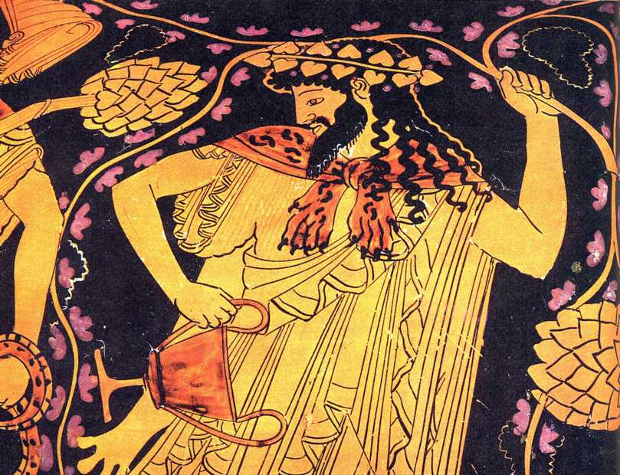

Slide 27
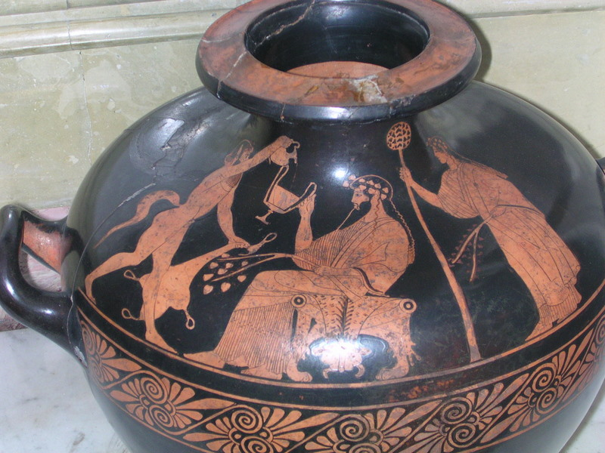
Red figure crater –
Satyr approaching Dionysos – Hermitage, Saint Petersburg

Slide 28
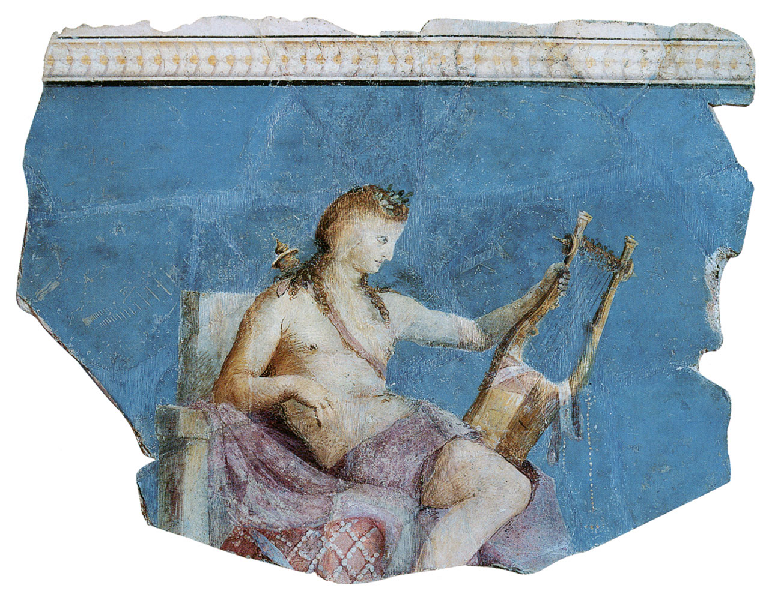
APollo

Slide 29
“Et in Arcadia ego” names two paintings by Poussin. Nietzsche writes of one of them:
“The beauty of the whole scene induced in me a sense of awe and adoration of the moment of its revelation; involuntarily, as if nothing were more natural, I inserted into this pure clear world of light (in which there was nothing of desire or expectation, no looking before or behind) Hellenic heroes … at one and the same time heroic and idyllic. -- And that is how individual men actually lived….”
(Human, all-Too-Human ii The Wanderer and his Shadow 296 KGW IV-3, 324)

Slide 30
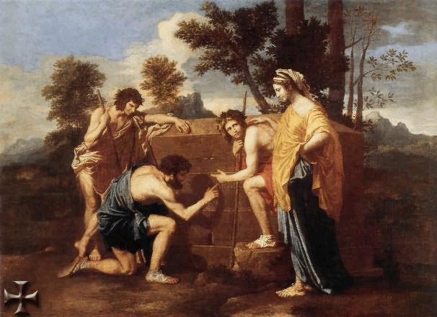
Poussin, Et in arcadia, ego

Slide 31
Apoxyomenos (“the scraper”) (found near Croatia)
“ …for here there is no place that does not see you. You must change your life.” – Rilke, Archaic Torso of Apollo
6 ft. 4 in

