Slide 1
HENRY DAVID THOREAU
1817-1862

Slide 2
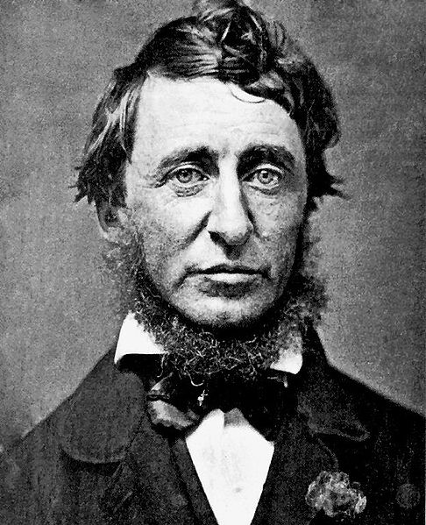
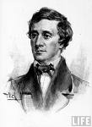
Thoreau, age 39
At 37

Slide 3
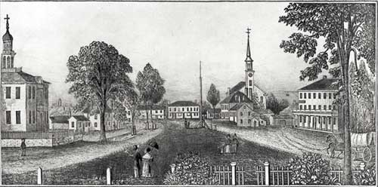
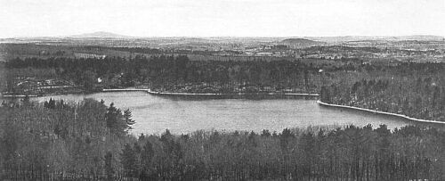
Concord, MA
Walden Pond

Slide 4
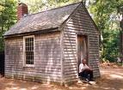
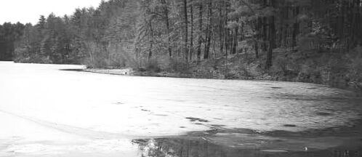
Reconstructed cabin
Pond in winter

Slide 5
Need for “wildness”
When I ask for a garment of a particular form, my tailoress tells me gravely, "They do not make them so now," not emphasizing the "They" at all, as if she quoted an authority as impersonal as the Fates, and I find it difficult to get made what I want, simply because she cannot believe that I mean what I say, that I am so rash. When I hear this oracular sentence, I am for a moment absorbed in thought, emphasizing to myself each word separately that I may come at the meaning of it, that I may find out by what degree of consanguinity They are related to me, and what authority they may have in an affair which affects me so nearly; and, finally, I am inclined to answer her with equal mystery, and without any more emphasis of the "they"—"It is true, they did not make them so recently, but they do now." Of what use this measuring of me if she does not measure my character, but only the breadth of my shoulders, as it were a peg to bang the coat on? We worship not the Graces, nor the Parcæ,but Fashion. (Walden (1854) : ‘Economy’)

Slide 6
“Live deliberately”
I went to the woods because I wished to live deliberately, to front only the essential facts of life, and see if I could not learn what it had to teach, and not, when I came to die, discover that I had not lived. I did not wish to live what was not life, living is so dear; nor did I wish to practice resignation, unless it was quite necessary. I wanted to live deep and suck out all the marrow of life, to live so sturdily and Spartan-like as to put to rout all that was not life, to cut a broad swath and shave close, to drive life into a corner, and reduce it to its lowest terms, and, if it proved to be mean, why then to get the whole and genuine meanness of it, and publish its meanness to the world; or if it were sublime, to know it by experience, and be able to give a true account of it in my next excursion. For most men, it appears to me, are in a strange uncertainty about it, whether it is of the devil or of God, and have somewhat hastily concluded that it is the chief end of man here to "glorify God and enjoy him forever.“ (Walden: “Where I lived” )

Slide 7
Acquire a perspective
My residence was more favorable, not only to thought, but to serious reading, than a university; and though I was beyond the range of the ordinary circulating library, I had more than ever come within the influence of those books which circulate round the world, whose sentences were first written on bark, and are now merely copied from time to time on to linen paper. Says the poet Mir Camar Uddin Mast, "Being seated, to run through the region of the spiritual world; I have had this advantage in books. To be intoxicated by a single glass of wine; I have experienced this pleasure when I have drunk the liquor of the esoteric doctrines." I kept Homer's Iliad on my table through the summer, though I looked at his page only now and then. Incessant labor with my hands, at first, for I had my house to finish and my beans to hoe at the same time, made more study impossible. Yet I sustained myself by the prospect of such reading in future. (Walden: Reading)

Slide 8
The Self
“Every man is the builder of a temple, called his body, to the god he worships, after a style purely his own, nor can he get off by hammering marble instead. We are all sculptors and painters, and our material is our own flesh and blood and bones. Any nobleness begins at once to refine a man's features, any meanness or sensuality to imbrute them.” (Walden: High Laws)

Slide 9
Live ecstatically
With thinking we may be beside ourselves in a sane sense. By a conscious effort of the mind we can stand aloof from actions and their consequences; and all things, good and bad, go by us like a torrent. We are not wholly involved in Nature. I may be either the driftwood in the stream, or Indra in the sky looking down on it. I may be affected by a theatrical exhibition; on the other hand, I may not be affected by an actual event which appears to concern me much more. I only know myself as a human entity; the scene, so to speak, of thoughts and affections; and am sensible of a certain doubleness by which I can stand as remote from myself as from another. However intense my experience, I am conscious of the presence and criticism of a part of me, which, as it were, is not a part of me, but spectator, sharing no experience, but taking note of it, and that is no more I than it is you. When the play, it may be the tragedy, of life is over, the spectator goes his way. It was a kind of fiction, a work of the imagination only, so far as he was concerned. This doubleness may easily make us poor neighbors and friends sometimes. (Walden: Solitude)

Slide 10
How is character formed
It was a singular experience that long acquaintance which I cultivated with beans, what with planting, and hoeing, and harvesting, and threshing, and picking over and selling them—the last was the hardest of all—I might add eating, for I did taste. I was determined to know beans. When they were growing, I used to hoe from five o'clock in the morning till noon, and commonly spent the rest of the day about other affairs. Consider the intimate and curious acquaintance one makes with various kinds of weeds—it will bear some iteration in the account, for there was no little iteration in the labor—disturbing their delicate organizations so ruthlessly, and making such invidious distinctions with his hoe, levelling whole ranks of one species, and sedulously cultivating another. (Walden: The Beanfield)

Slide 11
Civil Disobedience, 1849
Events: 1847, July; accosted by Sam Staples, tax collector and jailer for taxes not paid for 6 years.
Tolstoy and Ghandi

Slide 12
What does CD deal with?
1/ That government is best that governs not at all
2/ better government
3/ allegiance
4/ serving government
5/ disgrace
6/ thought and action
7/ what if my government is evil
8/ jail

Slide 13
What does CD accomplish?
1/ forces the state into recognition
2/ appeal to the people
3/ who is an agent of the government
But what about the list he cannot find?

Slide 14
Individualities
The central concern in CD is to limit government so as to allow the individual to flourish
People should not be seen as objects in need of repair
If engaged in seriously wrong action (slavery): should be disobeyed
Point: to defend the individual against any agency that is clearly distinct from the individual
and from a kind of social conformism
What is this individuality he wishes to promote (not individualism)
Negative individuality
To keep people from lending themselves to wrongdoing, to atrocity
Disobey: not just by washing ones hands (as he says)but by taking a stand to encourage others to do the same. (No church tax, no poll tax, help to runaway slaves, John Brown support)
Point is not to help others but to help oneself (I came into this world not chiefly to make this a good place to live, but to live in it, be it good or bad)
AND not to exploit others (“I must see first, at least, that I do not pursue [my pursuits] by sitting upon an other man’s shoulders. I must get off him first”)
Positive individuality
In Walden he calls this “living deliberately “(echoes of Socrates here) . TO be or become oneself. To take responsibility for oneself, the way an architect takes responsibility for a building
To have the courage not to hide from oneself (to get out of the closet as ones says nowadays)
This was the point of going to live at Walden Pond: the self as a project (cf Mill)
Impersonal individuality
Beyond the self as project: a kind of poetical relation to reality (this is more in Walden)
To see every person as beautiful (even when they conventionally are not)
To see each person as human
To see life as a kind of serious playfulness

