Slide 1
Edmund Burke
1729-1797

Slide 2
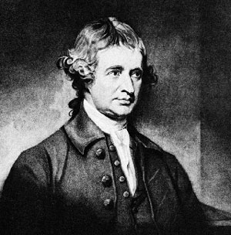

Slide 3
Life
Irish/ Protestant/ England
Burke and class Society
The French Revolution
Wordsworth: (The Prelude)
Oh! Pleasant exercise of hope and joy!
For mighty were the auxiliars which then stood
Upon our side, we who were strong in love!
Bliss was it in that dawn to be alive
But to be young was very heaven!
Notes:
Ut to be young was very heaven!

Slide 4
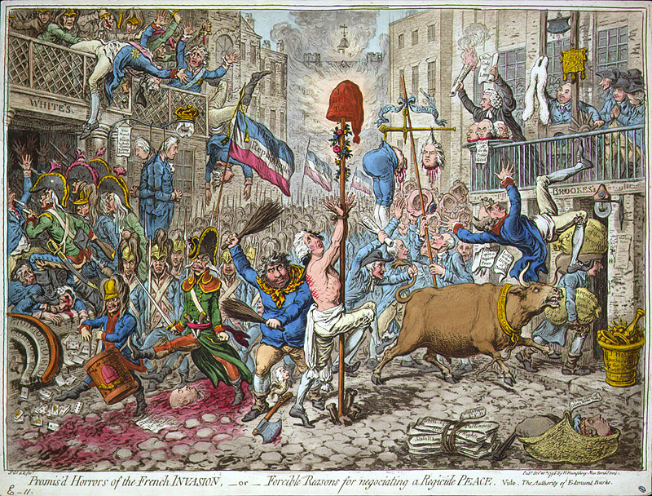
Burke’s view of the French Revolution

Slide 5
Revolutions and Burke
Execution of Charles I (1649)
Glorious Revolution (1688)
American Revolution (1776)
French Revolution (1789)
What are the important differences for EB?
Central points of his book
LIMITS OF HUMAN INTELLIGENCE
SOCIAL ORDER AND THE INTELLECT

Slide 6
Reflections on the Revolution in France
Price’s sermon
I. Critique of the posture of the “Revolutionary Society”
1.what should liberty be?
2.elements of government
II. English institutions
1. right to choose out own governors
2. right to cashier them for misconduct
3. right to frame government for ourselves

Slide 7
III. Proper mode of reform
Iv. What is wrong with France
Composition of the asembly
Proper criteria of just government
Horrors of the revolution
V. English institutions
Conservatism
Religion
VI. The policies of the Revolution

