Slide 1
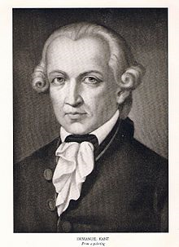
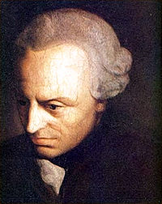
Immanuel Kant
1724-1804

Slide 2
Biography
Kantian epistemology (how do we know what we know?)
Problems from Rousseau and Hume
Shift to the question of judgment (not “the apple is red” but “I know the apple is red”
The Critique as fundamental mode

Slide 3
What kind of judgments”
Analytic synthetic
A priori objects have every change has a cause
extension
A posteriori Mont Blanc is 4610 meters high

Slide 4
How are synthetic a priori judgments possible?
Is there something that is human beyond being French, English etc?
Possibility of communication
Do I have reason to believe that I belong to a universal community
Significance of the fact that we do understand one another
These agreements are formal
Thus we are formally in a community
There is a higher truth which we cannot attain
(distinction of noumenal and phenomenal)

Slide 5
What is enlightenment?
“Dare to know”
Why indeed
do you hurry to remove things hurtful
to your eye, while if something is harmful to your
soul, you put off the time for curing it till next
year? Who begins a project has it half done; dare to know;
begin! Whoever postpones the hour of
living rightly is like the yokel who is waiting
until the river runs out: but it will glide
onwards and continue to glide forever in its flow.
(Horace, Epistles 1.2.40)

Slide 6
Who is enlightened?
Having one’s own voice
The sources of immaturity
Public versus private
What conditions are necessary to speak as a free person?

Slide 7
The Categorical Imperative
What principle makes moral judgments possible?
“Act only on that maxim which you can at the same time make a universal law”
Examples
Suicide
Lying
monogamy

Slide 8
Politics and International Relations
States in relation to each other
When is war justifiable?
Towards a Perpetual Peace
The League
Six articles that will reduce the likelihood of war
Idea for a Universal History
What makes for progress?

