Slide 1
Jean Jacques Rousseau
1712-1778

Slide 2
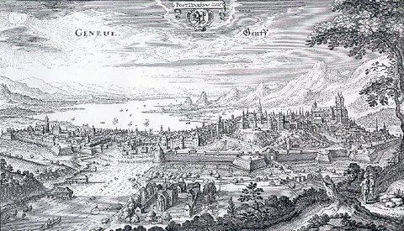

Slide 3
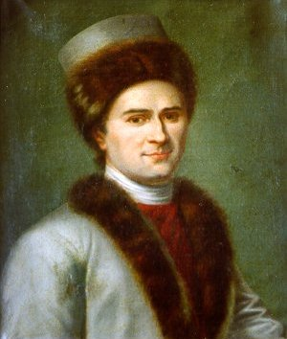
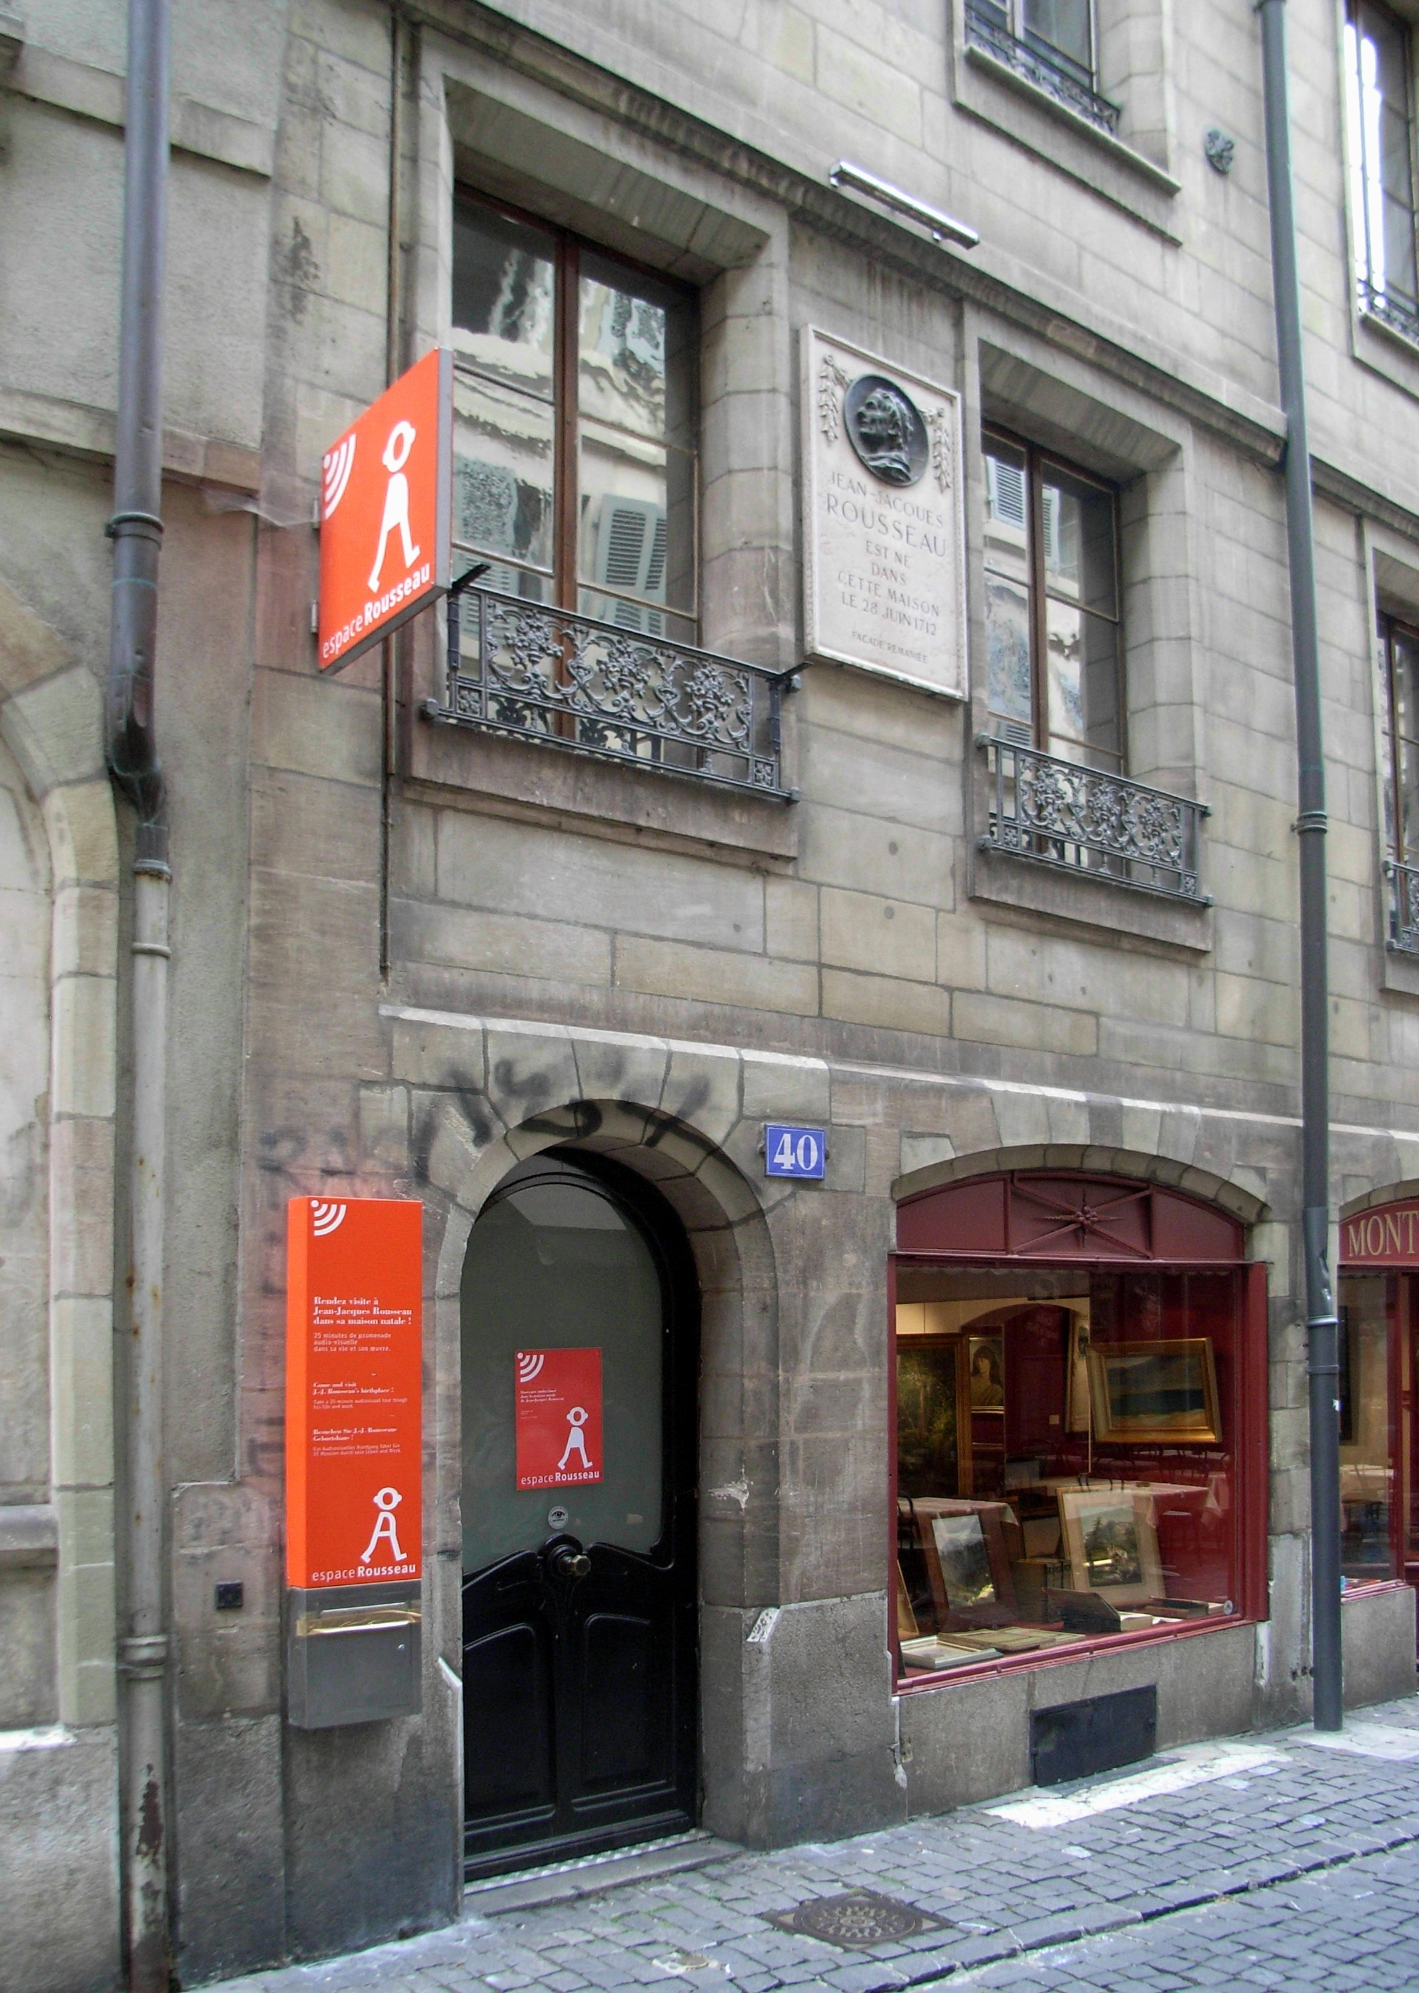
Riddle
Child of Art, Child of Nature,
Without prolonging time, I keep death back;
The truer I am, the more imposter.
And my aging makes me too young.

Slide 4
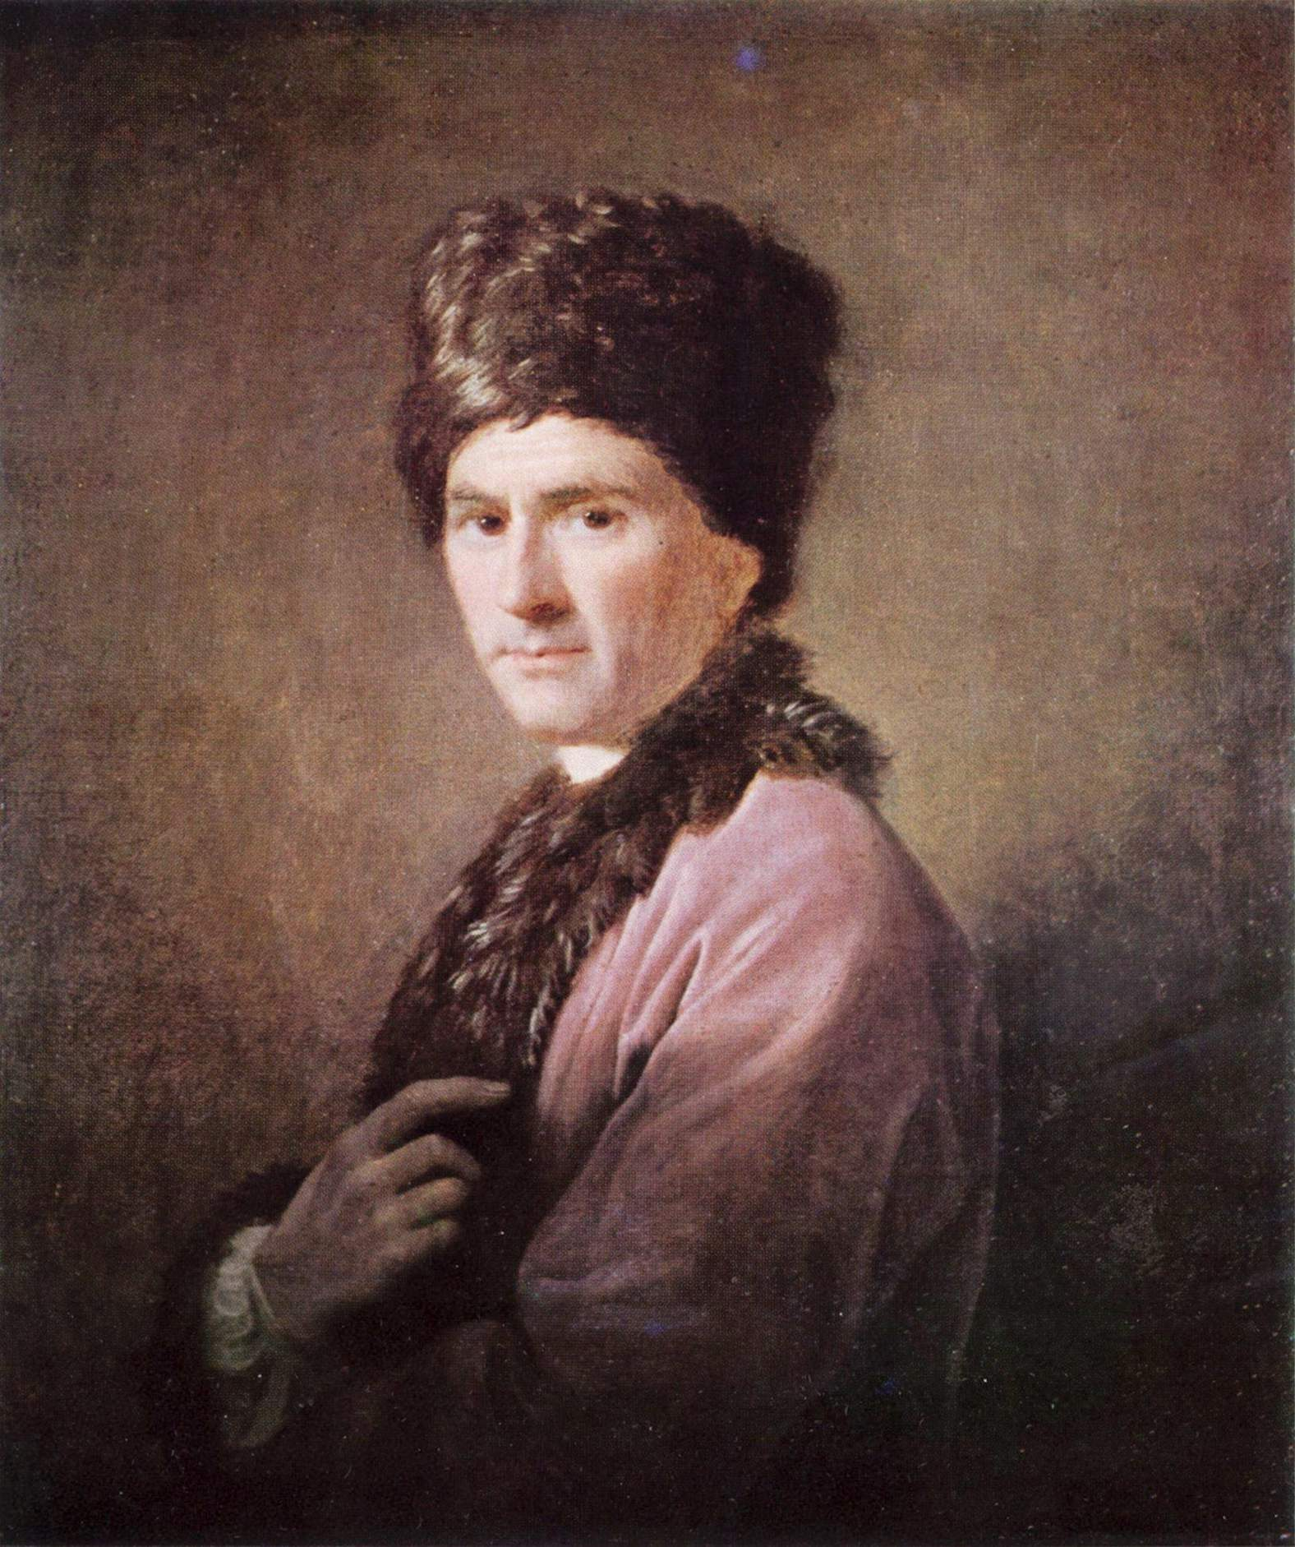
Those knowing in the art of pretense
Who give me such gentle features,
No matter how you wish to portray me
You will have only displayed yourselves.
--JJR, Dialogues, 2
How should one write to “persuade without convincing”?

Slide 5
http://www.youtube.com/watch?v=89BuvIOYQlk&feature=related

Slide 6
Title page and frontispiece of Discourse on the Arts and Science
Right: Prometheus receiving the fire and warning the satyr: “You do not know it”

Slide 7
Frontispieces to Discourse on Origin of Inequality
Caption on Right: “He returns to his equals.”

Slide 8
Title page and engravings
Dedication
Three gateways
Preface
Introduction
Distinction of two kinds of inequality
Critique of other hypotheses about the state of nature
Methodology
Setting the scene for the subject matter of the piece
Part I: Humans in the state of nature
Description of the physical aspects of the human
Metaphysical and moral aspects of the human
Metaphysical aspect
Origin of human passions
Difficulties re origin of language
Hypotheses as to the origin of language
The moral aspect
Moral qualities of natural man
Possible consequences
Conclusion of the first part
Part Two: the causes of life in society
Introduction: main thesis on property
First causes
First revolution: families
Appearance of primitive society: consequences of life in common
Fatality of chance
Development of all of our faculties
Growth of inequalities
Social compact
Governmental compact (causes of the different forms of government)
Progression of inequality
Causes of corruption
End point of corruption
conclusion
DISCOURSE ON THE ORIGIN OF INEQUALITY

Slide 9
Discourse on Origin of Inequality
Title change
Central question
The moment when in the progression of things right succeeded to violence, nature as subjected to law and to explain by what linkage of wonders the strong could resolve himself to serve the weak and the people to purchase repose at the price of true happiness
This is INEQUALITY

Slide 10
The idea of the common
Structure of the discourse
Entry porticos
Bulwark of the end
Approach:
Read
Nature of things
What are humans naturally (nature?)

Slide 11
How does it happen we are social
What are humans “naturally?
Not much at all (57)
How do we get society?
Accident
Property (64) cf Locke
Sequence is started
Cunning of the rich (69,70)

Slide 12
endgame
Last stage of inequality (77)
The fate of modern persons (80)
Is there hope?

Slide 14
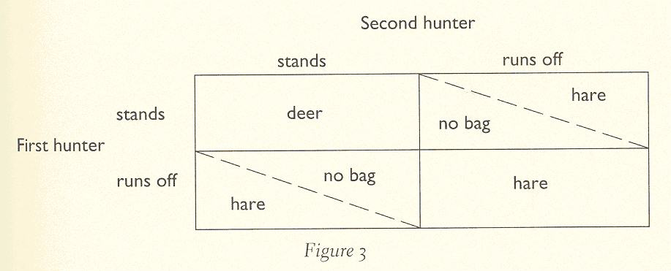
For one or none

Slide 15
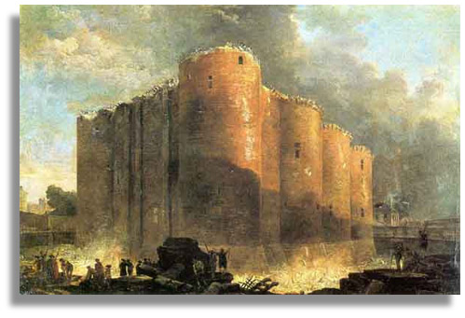

Slide 16
Social Contract
End of DOI and beginning of SC
Chains and freedom
Book I: The GENERAL WILL
General in relation to its object not those who hold it
Book II: Law
Sovereignty

Slide 17
Book III
Sovereignty and Government
Who contracts?
Representation?
Proportion of state

Slide 18
PROPORTION OF STATE
Sovereign Government
________ = ____________
Government People
i.e.
Goverment² = Sovereign x People
Or
Government = Sovereign x People

Slide 19
With numbers
____1___ = ___10____
10 100
If country is larger then:
1 100
______ = _____
100 1000

