Slide 1
John Locke
1632-1704

Slide 2
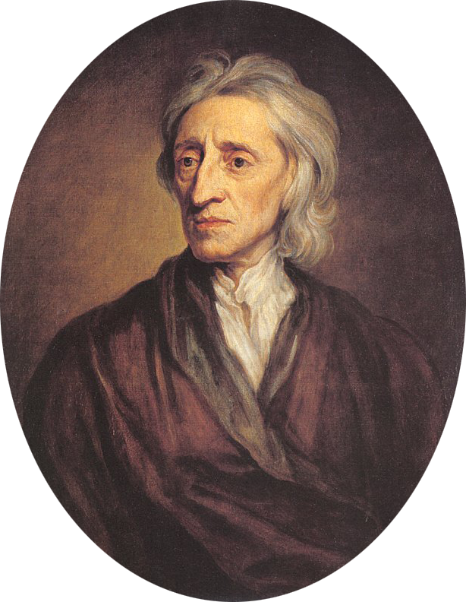
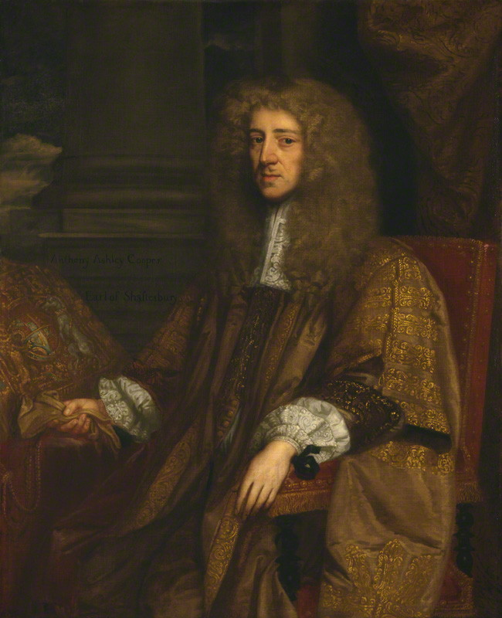
Political Context: Exclusionary Act; Charles II; James II; Glorious Revolution
Locke: Biography: Oxford; doctor; Earl of Shaftesbury

Slide 3
Two Treatises of Government 168?
An Essay Concerning Human Understanding...1690
A Letter Concerning Toleration
Some Thoughts Concerning Education…

Slide 4
The story of the Two Treatises and their timing
I. Distinction of Right and Duty
Centrality of freedom (contrast Hobbes?)
II. State of nature is state of freedom: how?
Born free (4, 61)
Where no law no freedom (57)
Law of nature is law of freedom (61)
State of nature not state of license (6)
III. What is reason?
Equated with conscience (8)
Entitles you to be executioner of law of nature (8)
Should rule (172)

Slide 5
IV. Still in state of nature
Everyone has executive power (13)
Problem that each is judge in his own case (125)
In the beginning all was America (49)
Resources as problem; Enclosure Acts
V. The question of Property and power (Chap 5)
Property in the person (27)
Imperative to acquire (35)
How
VI. Move to civil society
Money
What restrictions?
What imperative?
VII. Is there a double notion of property?
Property, equality and inequality
women

Slide 7
Attitude towards America type lands and peoples: from the Fundamental Constitution of the Carolinas
Article 97: Since the natives of that place, who will be concerned in our plantation, are utterly strangers to Christianity, whose idolatry, ignorance, or mistake gives us no right to expel or use them ill; and those who remove from other parts to plant there will unavoidably be of different opinions concerning matters of religion, the liberty whereof they will expect to have allowed them, and it will not be reasonable for us, on this account, to keep them out; that civil peace may be maintained amidst diversity of opinions, and our agreement and compact with all men may be duly and faithfully observed; the violation whereof, upon what presence soever, cannot be without great offence to Almighty God, and great scandal to the true religion which we profess; and also that Jews, heathens, and other dissenters from the purity of Christian religion may not be scared and kept at a distance from it, but, by having an opportunity of acquainting themselves with the truth and reasonableness of its doctrines, and the peaceableness and inoffensiveness of its professors, may, by good usage and persuasion, and all those convincing methods of gentleness and meekness, suitable to the rules and design of the gospel, be won over to embrace and unfeignedly receive the truth; therefore, any seven or more persons agreeing in any religion, shall constitute a church or profession, to which they shall give some name, to distinguish it from others.
Property requirements: to vote: 50 acres; to be a candidate: 500 acres

Slide 8
VIII. Politics as border maintenance
What is needed
What is given up
IX. Who rules?
Two contracts (compare Hobbes)
X. What about rebellion?
The people judge (who is the people?)
What if it is really bad (Charles I; James II)
XI. What is consent (110-120)
Citizens and foreigners

