Slide 1
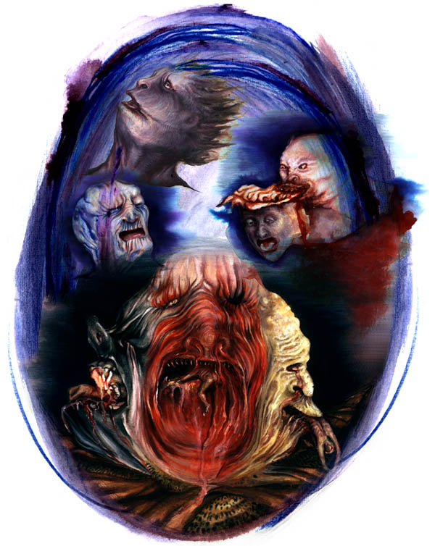
Brutus in the 9th circle of Hell (Dante, Inferno, canto 34) – early 1300’s

Slide 2
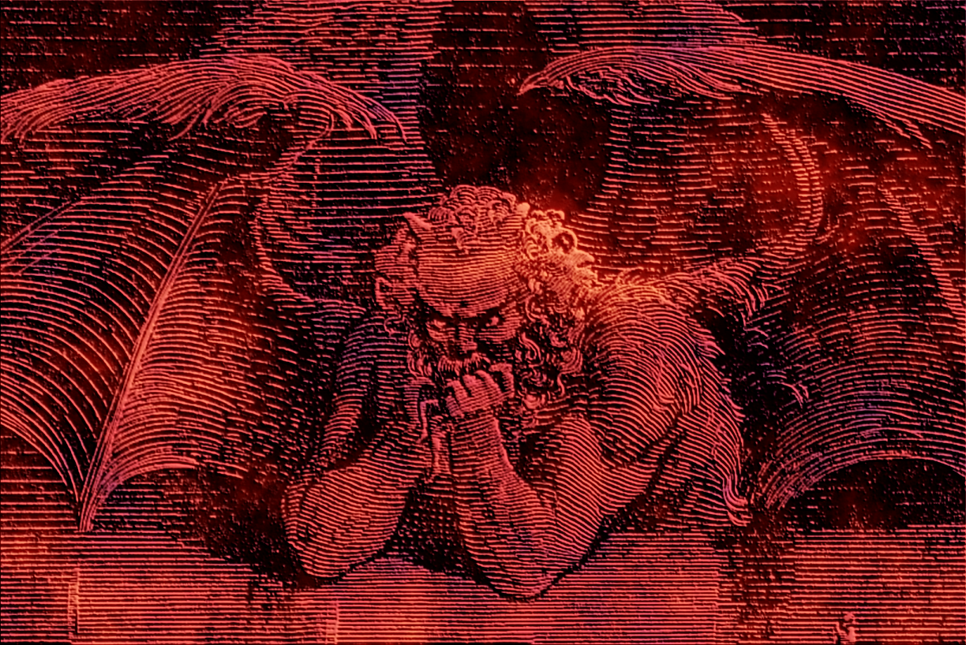

Slide 3
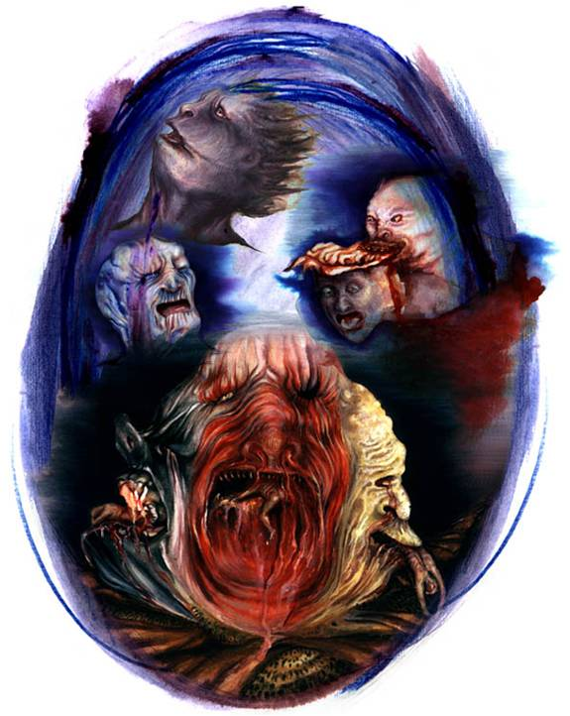

Slide 4
Brutus in Shakespeare, Julius Caesar, V, v (1600)
MESSALA How died my master, Strato? STRATO I held the sword, and he did run on it. MESSALA Octavius, then take him to follow thee, That did the latest service to my master. ANTONY This was the noblest Roman of them all: All the conspirators save only he Did that they did in envy of great Caesar; He only, in a general honest thought And common good to all, made one of them. His life was gentle, and the elements So mix'd in him that Nature might stand up And say to all the world 'This was a man!' OCTAVIUS According to his virtue let us use him, With all respect and rites of burial. Within my tent his bones to-night shall lie, Most like a soldier, order'd honourably. So call the field to rest; and let's away, To part the glories of this happy day. Exeunt

Slide 5
Niccolo Machiavelli
1469-1527

Slide 6
Florence

Slide 7
Piazza della SIgnoria

Slide 8
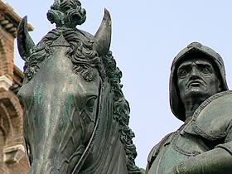
Bartolommeo Colleone, by Verrocchio

Slide 9
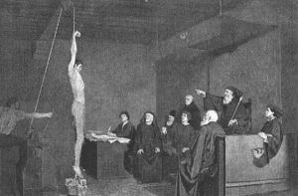
Machiavelli

Slide 10
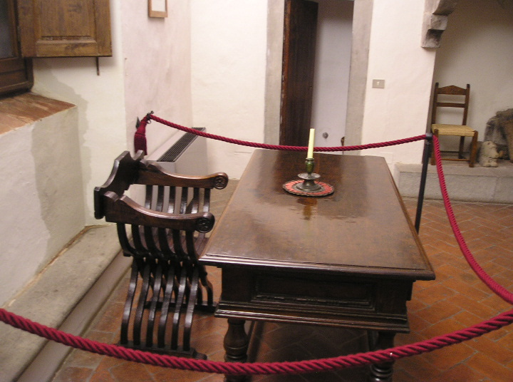

Slide 11
Il Principe (1513; pub 1532)

Slide 12
Translation?
The virtues of virtuous translation: Prince, chapter 8: VIRTÙ
Chi considerasse adunque li azione e virtù di costui [Agathocles], non vedría cose o poche le quali possa attribuire alla fortuna .... Non si puo encora chiamare virtù amazzare i suoi cittadini.... Perché se si considerasse la virtù di Agatocle nell’entrare e nell’uscire de’pericoli.... No si può adunque attribuere alla fortuna o alla virtù quello che senza l’une e l’atera fu da lui consguito.
Version 1:
He who considers, then, the actions and virtues of this man [Agathocles], will see nothing or little that can he can ascribe to fortune.... It cannot, however be called virtue to kill one’s fellow citizens, ... If we consider Agathocles’ ability in entering into and getting out of danger .... We cannot then attribute to fortune or to virtue what he accomplished without the one or other.
Gilbert translation
Version II:
Whoever considers, therefore, the actions and qualities of this man, will see few things that can be attributed to fortune... It cannot be called virtue to kill one’s fellow citizens.... For if the virtues of Agathocles in braving and overcoming perils.... We cannot attribute to fortune or virtue that which he achieved without either.
Ricci translation
Version III:
Thus whoever may consider the actions and virtue of this man will see that nothing or little can be attributed to fortune... Yet one cannot call it virtue to kill one’s citizens... For if one considers the virtue of Agathocles in entering into and escaping these dangers... Thus one cannot attribute to fortune or to virtue what he achieved without either.
Mansfield translation
Version IV
If you consider Agathocles’ bold achievements ... . One ought not , of course, to call it virtue or manliness to massacre one’s fellow citizens... . If one considers the manly qualities Agathocles demonstrated .... It is clear, at any rate, that one can attribute neither to luck nor to virtue his accomplishments, which owed nothing to either.
Wootten translation (assigned text)
I II III I V
a/ virtues qualities virtue achievements
b/ virtue virtue virtue virtue or manliness
c/ ability virtues virtue manly qualities
d/ virtue virtue virtue virtue

Slide 13
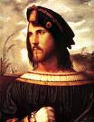
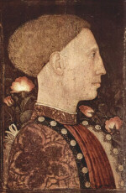
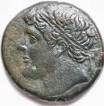
THE DIFFERENT KIND OF PRINCELY ACTIONS
HIGH VIRTU LOW VIRTU
HIGH FORTUNE Contemporary innovator: Borgia, chapter 7 Unnamed at chapter 7
LOW FORTUNE Chapt. 6: Moses, Cyrus, Romulus, Hiero Este of Ferrara -traditional
Cesare Borgia Hiero Duke Este

Slide 14
CHAPTER ONE – THE MAIN SUBJECT MATTER
STATES
REPUBLICS PRINCEDOMS
NEW HEREDITARY
ALL NEW ACQUIRED
USED TO PRINCE OWN FORCES BY OTHERS FREE

Slide 15
Organization of THE PRINCE
1-2: The question of innovation
3-5: relation of power of Prince to structure of society
6-9: areas in which virtù yields to fortune
10-14: reliance on the military
15-21: personal conduct with subjects
22-23: advisors
24-25: what can go wrong
26: arena for a Prince (Italia mia)

Slide 16
Who Machiavelli: you have an excellent introduction in your volume
THE PRINCE -- intention
when tradition will no longer do
observation of “real life”
this is a new source of political virtue: start with relations between humans as they are, not with principles. Task is not to make clear at first what people should do, but what they do do.

Slide 17
we must replace heredity with ability
we must make the new seem old/ make men forget their origins; make the focus so much on the present and the future that they forget the past
In chapter 1 he tells you with great economy what is going to concern him:
states: republics or principalities (ruled by one)

Slide 18
What is the Human condition for Machiavelli”
human affairs are to a great extent the product of human action
there are two kinds of action (M calls these umori in chapter 9)
This division is new:

Slide 19
What are the principles governing the relationship between the two groups? (M investigates this throughout his work)
human affairs are in flux and cannot stand still (D I, 6)
men find this difficult to take and desire constants
indecision is bad
but there are no real constants, only conditions
thus to base your policy on what appears to be permanent reality is always to be wrong. There is NOTHING to stand on.
Politics becomes the art of unmasking illusions for yourself and of making them for others, without them know that what they see is illusion.
“Men judge more by sight than by touch (P 18 -55) and the eyes betray us.
Summary of all this in the first parag of P24 (72)

