Slide 1
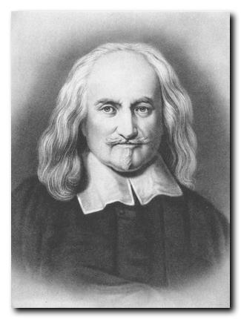
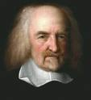
Thomas Hobbes, 1588-1679

Slide 2
Frontispiece

Slide 3
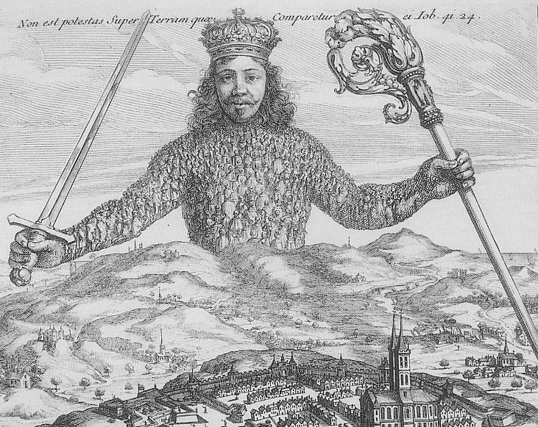
detail

Slide 4
Detail of detail

Slide 5
?

Slide 6
Breughel – Fall of Icarus - 1558

Slide 7
Icarus
Musée des Beaux Arts by W.H. Auden
About suffering they were never wrong, The Old Masters; how well, they understood Its human position;
… In Breughel’s Icarus, for instance: how everything turns away Quite leisurely from the disaster; the ploughman may Have heard the splash, the forsaken cry, But for him it was not an important failure; the sun shone As it had to on the white legs disappearing into the green Water; and the expensive delicate ship that must have seen Something amazing, a boy falling out of the sky, had somewhere to get to and sailed calmly on.

Slide 8
Leviathan
HOBBES’ DIAGNOSIS: Hobbes has 3 principles
good politics are built on men as they are, but not as they behave -- adds an interior dimension to Machiavelli (p. 6)
fear of violent death (Good Lord deliver us)
Hobbes thinks that people should be afraid of dying
experience of civil war makes it clear that they were not
people dying for religious beliefs
Socrates CONTRA
people make mistakes about who they are -- not so much a about the world , but about themselves.
They do not find the human in themselves
they think themselves something special and different but they are not.
Hence this is a complex revision of Socrates :”know thyself” but also a warning against finding anything in yourself which is not in others.
Breughel, The Fall of Icarus

Slide 9
THE mistakes they make are:
insufficiency of speech ( chapter 1 (p. 8)
e.g. page 24 -25 (chapter 5 on spirit)
what is the power of Speech in Hobbes? In chapter 4: there is nothing in the world universal but names.”
And noted in the Autobiography which you have in your edition, on page lvi: the one thing he knows to be fixed
The power of names like in a book of definitions. Note that definitions do not only tell you what something is, they tell you what you can do with it -- what it does. (E.G. definitions in chess)
insufficiency of method
chapter 5 p 26: children need to be taught reason: it takes work
THIS means that morality and politics are arrived at and are interpersonal.
What if we do not have them?
Chapter 13 (76)
touch of paranoia --se following example)

Slide 10
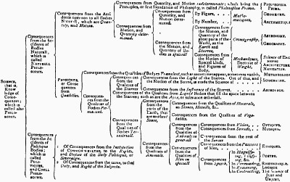
Chapter IX– The Kinds of Knowledge

Slide 11
Chapter 14-16
Chapter 14: natural law and natural right
Chapter 15: in foro interno and in foro externo
Chapter 16:
Persons – what they are
Natural
Artificial
Author
Actor

Slide 12
Authorization
Knowlable
Rational
Possible
Authorization and representation
Consequences
Private judgment?
Must recognize
Absurdity of war
That one is afraid
universality

Slide 13
Obligation
The making of one artificial person by a
Covenant
Between all
Three elements
Artificial authorized person
Obligation
Likelihood
Attributes of sovereign

Slide 14
Sovereign

Slide 16
The same in each
Monarchy, aristocracy, democracy
Master of rules
Rules and freedom
What then is justice?
How and why should promises be kept?
What is the purpose?
Implications
Classless
Private and public

Slide 17
Liberty of Subjects
essence is that society and covenant should not make you worse off
basic def on 137 chapter 21 - a freeman
what is not covered
defend yourself
hurt yourself
not kill others unless for aims of sovereignty
not to war unless voluntary --
theory of British Army until 1847
that which is not forbidden
generally speaking as long as governed -
basic point: submission is liberty

Slide 18
The State
Beneficient
Private enterprise
Not self defeating
One’s own thing
Restrict greed
Property
Rebellion

Slide 19
What comes from this?
Sociability?
Justice/law/discipline/sanctions
Negative great commandment
What if a bad sovereign?

Slide 20
Reading oneself -- again
Of arts some are demonstrable, others indemonstrable; and demonstrable are those the construction of the subject whereof is in the power of the artist himself, who, in his demonstration, does not more than deduce the consequences of his own operation… Geometry therefore is demonstrable, for the lines and figures from which we reason are drawn and described by ourselves; and civil philosophy is demonstrable because we make the commonwealth ourselves.
--Hobbes, Six Lessons to the Professors of Mathematics

Slide 21
Hobbes’ “Review and Conclusion”
Truth of doctrine rests
On no writer
Not established by facts
Owes nothing to antiquity
So what kind of book is this?

