Slide 1
William Shakespeare, 1564-1616

Slide 3
Globe Theatre today

Slide 4
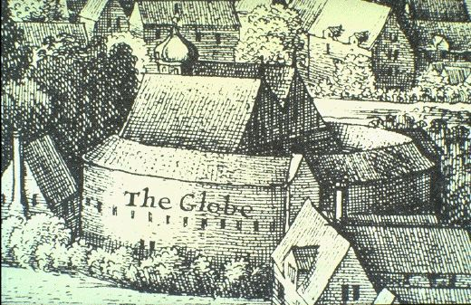
London, 1574
The Globe Theatre

Slide 5
First Folio (1623)

Slide 6
Succession from Edward III until Henry VII

Slide 7
Plantagenets and Roses
EDWARD III (1322-1377) (PLANTAGENET)
______________________________________________________________________________________________
Edward (the Black John of Gaunt Edmund,
Prince) Duke of LANCASTER Duke of YORK
RICHARD II m. Blanche m. Catherine Seynford Richard,
(1377-1399) Earl of Cambridge
HENRY IV John Beaufort
(1399-1413)
HENRY V John Beaufort Richard,
(1413-1422) Duke of York, m Cicely Neville
HENRY VI (1422-1461/1470-1471)
Edward ,Prince of Wales (d.1471) Margaret Beaufort m Edmund Tudor
HENRY VII (1485-1509)
TUDOR DYNASTY
_______________________________________________________________________________________________
EDWARD IV Edmund, Earl of Rutland Clarence, Duke of Clarence RICHARD III
(1461-1483) (1483-1485)
m. Eliz. Woodville m. Anne Neville
__________________________________________________
Eliz. of York EDWARD V (d. 1483) Richard, Duke of York (d. 1483) Edward, Prince of Wales (d. 1485)
(m. HENRY VII)
HENRY VIII (etc)

Slide 8
SHAKESPEARE
Question of the possibility of hyper-machiavellianism
RICHARD III -- written 1591-1594
General question of using plays
play is the thing
Shakespeare and politics
the times: much like the Renaissance
Inside this a temptation to refuse politics:
Renaissance idyll
Against the golden idyll of As you like it we have a new and pressing concern:
The presence of self-conscious beings who reject that world and use it against itself.
The opening soliloquy
more importantly: he uses the old against itself
a new and fascinating figure: the Machiavellian ( H vi 3: 529)

Slide 9
Richard Gloucester, Henry VI, 3, Act III, scene 2
Why, I can smile, and murder whiles I smile, And cry 'Content' to that which grieves my heart, And wet my cheeks with artificial tears, And frame my face to all occasions. I'll drown more sailors than the mermaid shall; I'll slay more gazers than the basilisk; I'll play the orator as well as Nestor, Deceive more slily than Ulysses could, And, like a Sinon, take another Troy. I can add colours to the chameleon, Change shapes with Proteus for advantages, And set the murderous Machiavel to school. Can I do this, and cannot get a crown? Tut, were it farther off, I'll pluck it down.

Slide 10
Richard III, Act I, scene 1
Now is the winter of our discontent Made glorious summer by this sun of York; And all the clouds that lour'd upon our house In the deep bosom of the ocean buried. Now are our brows bound with victorious wreaths; Our bruised arms hung up for monuments; Our stern alarums changed to merry meetings, Our dreadful marches to delightful measures. Grim-visaged war hath smooth'd his wrinkled front; And now, instead of mounting barded steeds To fright the souls of fearful adversaries, He capers nimbly in a lady's chamber To the lascivious pleasing of a lute. But I, that am not shaped for sportive tricks, Nor made to court an amorous looking-glass; I, that am rudely stamp'd, and want love's majesty To strut before a wanton ambling nymph; I, that am curtail'd of this fair proportion, Cheated of feature by dissembling nature, Deformed, unfinish'd, sent before my time Into this breathing world, scarce half made up, And that so lamely and unfashionable That dogs bark at me as I halt by them; Why, I, in this weak piping time of peace, Have no delight to pass away the time, Unless to spy my shadow in the sun And descant on mine own deformity:

Slide 11
And therefore, since I cannot prove a lover, To entertain these fair well-spoken days, I am determined to prove a villain And hate the idle pleasures of these days. Plots have I laid, inductions dangerous, By drunken prophecies, libels and dreams, To set my brother Clarence and the king In deadly hate the one against the other: And if King Edward be as true and just As I am subtle, false and treacherous, This day should Clarence closely be mew'd up, About a prophecy, which says that 'G' Of Edward's heirs the murderer shall be. Dive, thoughts, down to my soul: here Clarence comes.

Slide 12
http://www.youtube.com/watch?v=ke5-SUDrHMU

Slide 13
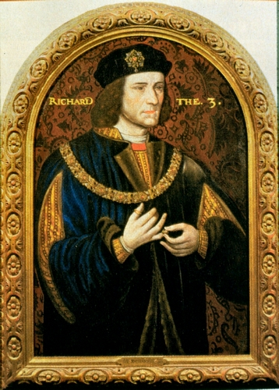
Richard III
Henry VII

Slide 14
What is R III about
the power of illusion - S is fascinated with the character -- one of the longest parts in shortest plays; appears all the time.
what if all the world is a stage (or a cave)?
About ties between humans and their lack

Slide 15
What is the role of the Prince in such a world
new problem: who am I when I am not a king: Richard II: abandonment of the notion of kingly right
We shall say:
Richard knows he needs to create a kingdom (stato)
how does he do this?
Opening sol. Renounces love and ties (554)
“I cannot prove lover” but seduces Anne
Uses the energy of others
or again: uses populace for continuity
HAS SUCCESS
problem comes in the exchange with Elizabeth
forced to deny time to make his point even though the consciousness of time in others was what had given him his power
memory comes back: even though the past is an illusion it cannot be gotten rid of
dream sequence
BUT is forced at end to rely on naked strength; having no community with others, he has none with himself.
defeated and sexual and political peace is reestablished
You are what you pretend to be, therefore be careful about what you pretend

